Slide 1
Continuous Monitoring in Early Oncology Dose Optimization
Pat Mitchell, MA

Slide 2
Agenda
Motivation
Traditional design vs new approach
Continuous monitoring role
Monitoring variables
Operating characteristics
Monitoring chart

Slide 3
Recent trends lead to FDA project OPTIMUS
High rate of dose reductions and discontinuations due to Adverse events (AE) with targeted therapies
Numerous tolerability and adherence issues
FDA recommendations regarding dosing not incorporated
High number of
  Post marketing requirements
  Post marketing commitments
Clin Cancer Res (2016) 22 (11): 2613–2617.

Slide 4
Guiding Principles for Dose Optimization Study Design
 | Design Aspects
Study design | Flexible designs and early access to data to allow changes based on emerging clinical data
Patient population | Perform dose finding studies in subjects intended to treat
Doses | Test >1 dose levels Test doses that are differentiated based on pharmacokinetics (PK), pharmacodynamic (PD) or efficacy (ex: potentially non-overlapping PK exposures) Lower dose has reasonable possibility to be efficacious
Sample size | Sample size in phase 1 to evaluate exposure/dose response - use model-based approach to analyze data and select the right dosage regimen(s) Don’t need to show statistically significant difference between doses in cohort expansions
PD/Efficacy endpoints | Tumor growth or overall response (ORR) Use target occupancy, target engagement or down stream PD endpoints or any other qualified biomarkers as supportive evidence
Safety endpoints | Use all available safety data and sufficient duration of exposure to adequately assess tolerability
Randomization | Where possible and necessary use randomization
Slide adapted from Pavan Vajjah, CPQP

Slide 5
Traditional Phase 1 paradigm
DL5
DL4
Dose level (DL) 4?
DL3
DL2
DL1
Escalation
Small cohorts N = 3 - 6
Escalation decisions based on Dose limiting toxicity (DLT)
Limited period of DLT observation
Expansion
Sample size driven by efficacy
Safety secondary
Safety events considered

Slide 6
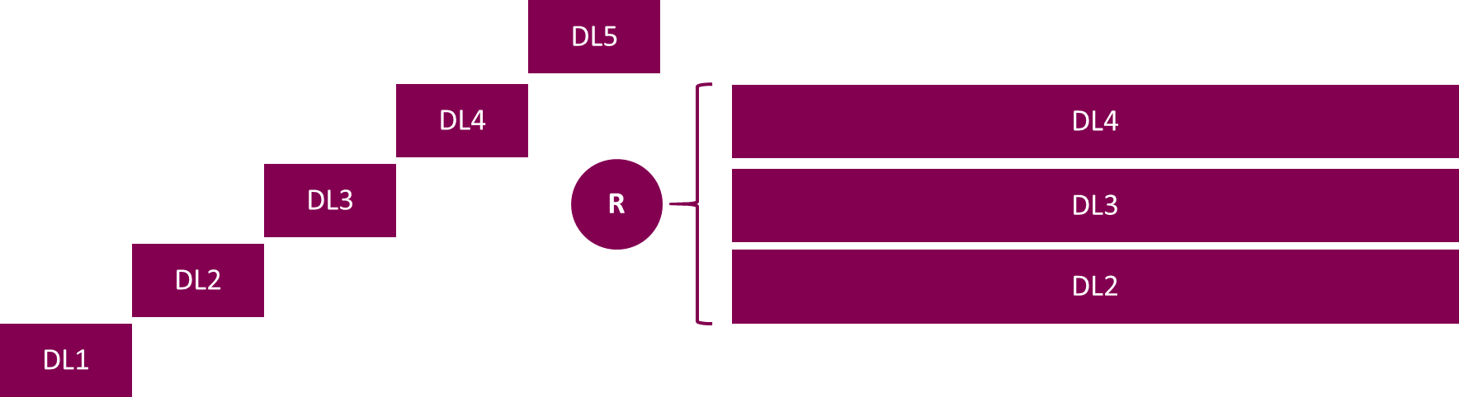
Our design allows fuller consideration of the dose range
Escalation
Small cohorts
Escalation decisions based on DLT
Limited period of DLT observation
Expansion
Randomize to multiple expansions for dose optimization
Sample size driven by efficacy
Want to show dose response trend
Early stop / Recommended Phase 2 Dose (RP2D) nomination based on prespecified criteria
Sufficient follow-up for safety and efficacy events

Slide 7
All open dose cohorts will have minimum information
DL5
DL4
R
DL3
Patients exposed
Patients planned
Patients originally planned but not exposed
DL2
DL1
Min N
Each dose has a minimum number of patients
Monitoring begins following the minimum number of patients needed for a good decision (Min N) to enable decision making
Sufficient data for exposure response
R: randomization

Slide 8
Unsuitable dose cohorts will stop early
DL5
DL4
R
DL3
Patients exposed
Patients planned
Patients originally planned but not exposed
DL2
DL1
Min N
Early stopping for toxicity or lack of efficacy
Fewer patients exposed to doses not likely to be developed

Slide 9
Continuous monitoring enables early declaration of RP2D
DL5
DL4
R
DL3
Patients exposed
Patients planned
Patients originally planned but not exposed
RP2D declared
DL2
DL1
Min N
Early identification of RP2D candidates
Increase information in promising doses
Doses that reach RP2D may be expanded to full planned sample size (Max N)

Slide 10
Monitoring vs Decision Variables
Safety
Efficacy
Goal: identify and stop toxic doses before reaching Max N
Goal: identify and stop ineffective doses before reaching Max N
Gr 3/4 AEs, dose interruptions, reductions or DAE
DCR or uPR/uCR + BM change or confirmed PR / CR
DLT
Confirmed CR/PR
Relevant for dose escalation
Limited evaluation period
Standard early efficacy variable
Two follow up scans post baseline
Broader set of events
No limit on follow-up
Broader response variable
Achievable in one scan

Slide 11
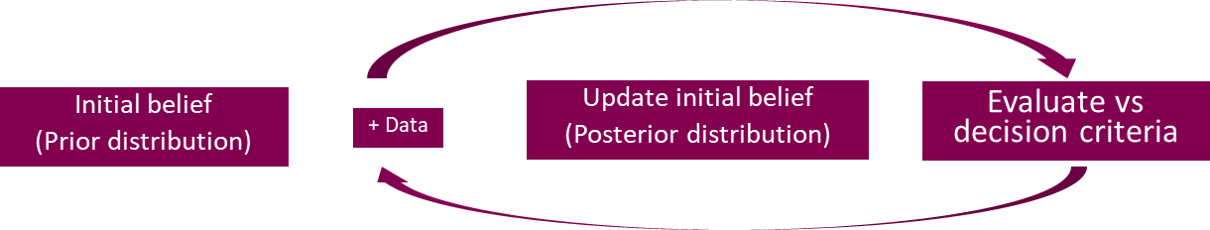
Continuous Monitoring Decision Procedure
 | Safety | Efficacy
Target | 30% | 38%
Endpoint | Incidence of safety event | Proportion of patients with efficacy event
Criteria for stop (either) | At least 95% chance that safety > 30%* i.e. High chance the dose level is not tolerable | At least 90% chance that the efficacy <38% ** i.e. High chance the dose level is not efficacious
Criteria for RP2D (both) | At least 80% chance that safety < 30%⁺ i.e. High chance the dose level is tolerable | At least 80% chance that the efficacy >38%⁺⁺ i.e. High chance the dose level is efficacious
Ineffective doses or excessively toxic doses will be stopped on that declaration
RP2D declaration if potential for good efficacy and safety
Doses that reach RP2D declaration may be expanded to Max sample size (N=40 in this case)
Continuous monitoring begins with the 10th patient
Uniform prior used for simulations
*P[proportion of patients with safety events < 30% | data] > 95%; **P[proportion of patients with efficacy events < 38% | data] > 90%
+P[proportion of patients with safety events > 30% | data] > 80% ; ++ P[proportion of patients with efficacy events < 38% | data] > 80%

Slide 12
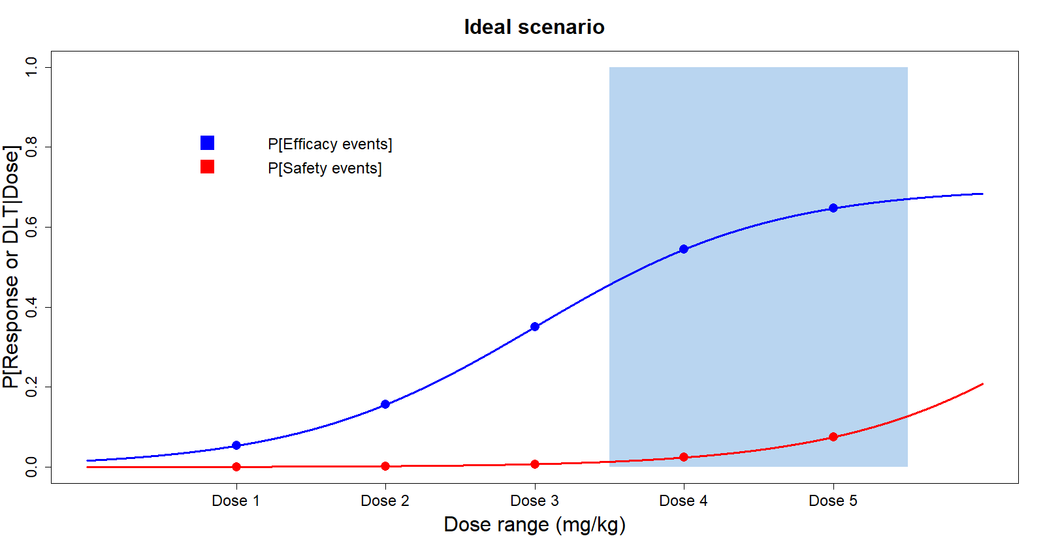
Continuous monitoring can distinguish between unsuitable doses and RP2D candidates
Lower doses not effective with low toxicity
Higher doses more effective with relatively low toxicity
 | Dose1 | Dose2 | Dose3 | Dose4 | Dose5
YES | 0% | 0.90% | 35.20% | 95.50% | 99.80%
NO | 100% | 98.50% | 36.40% | 1.70% | 0.10%
UNC | 0% | 0.60% | 28.40% | 2.80% | 0.10%
SS | 10.3 | 13.3 | 23.5 | 14.1 | 11.8
SS + 1SD | 11.37 | 18.97 | 36.08 | 21.43 | 15.42
SS + 2SD | 12.44 | 24.64 | 48.66 | 28.76 | 19.04
YES: RP2D declared; NO: dose unsuitable; UNC: insufficient information following N=40 to decide
Notes:
# parameterize efficacy dose response
MaxE <- 0.7 # must be [0,1]
E5E <- 40 # dose at 50% of efficacy effect
S5E <- 0.25 # slope at E51
# parameterize safety dose response
MaxS <- 0.9 # must be [0,1]
E5S <- 80 # dose at 50% of efficacy effect
S5S <- 0.24 # slope at E51

Slide 13
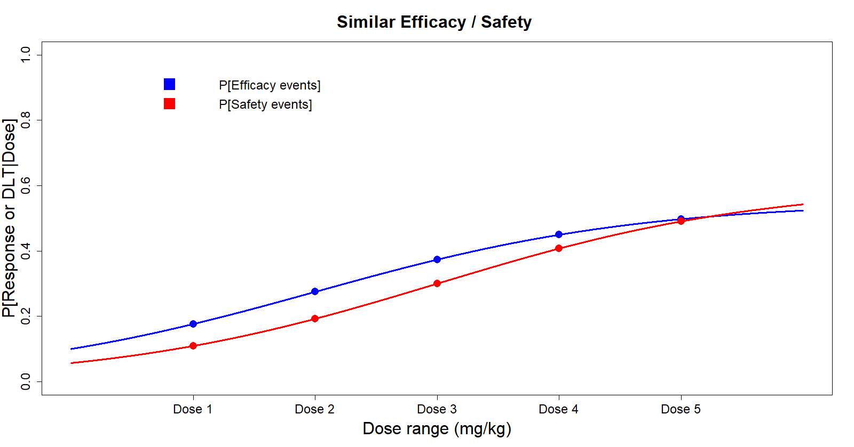
Continuous monitoring is sensitive to toxic and in effective doses
Lower doses not effective with relatively low toxicity
Higher doses more effective with relatively high toxicity
 | Dose1 | Dose2 | Dose3 | Dose4 | Dose5
YES | 1% | 7.80% | 13% | 5.50% | 1.50%
NO | 97.50% | 71.80% | 41.20% | 66.80% | 91.30%
UNC | 1.50% | 20.40% | 45.80% | 27.60% | 7.30%
SS | 14.4 | 22.2 | 28.2 | 23.7 | 17.3
SS + 1SD | 21.33 | 34.02 | 40.84 | 36.15 | 27.03
SS + 2SD | 28.26 | 45.84 | 53.48 | 48.6 | 36.76
YES: RP2D declared; NO: dose unsuitable; UNC: insufficient information following N=40 to decide
Notes:
# parameterize efficacy dose response
MaxE <- 0.7 # must be [0,1]
E5E <- 40 # dose at 50% of efficacy effect
S5E <- 0.25 # slope at E51
# parameterize safety dose response
MaxS <- 0.9 # must be [0,1]
E5S <- 80 # dose at 50% of efficacy effect
S5S <- 0.24 # slope at E51

Slide 14
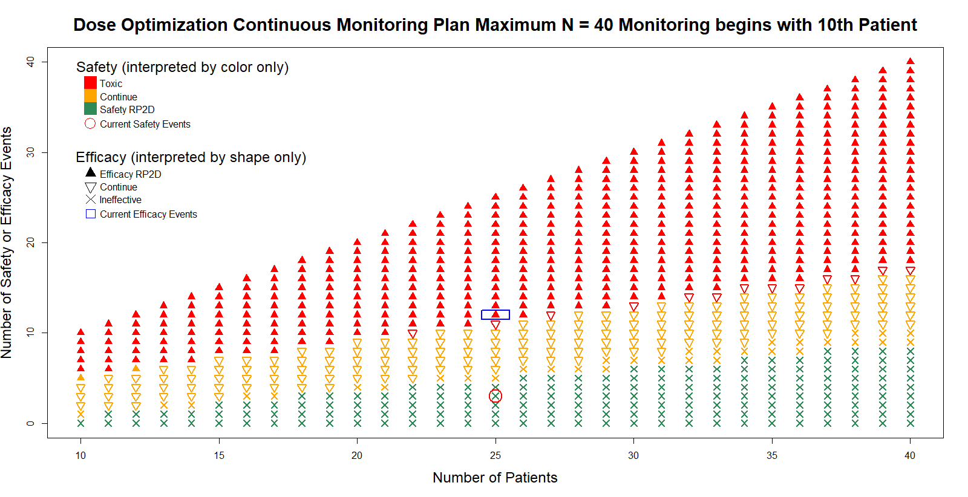
No Math Necessary Once the Decision Parameters Are Adopted

Slide 15
Summary
One approach to project OPTIMUS
  Minimizes overall sample size in ineffective or toxic doses
  Focuses on promising doses
  Provides sufficient data for holistic consideration of all doses
Awaiting feedback from FDA

Slide 16
Acknowledgements
Pavan Vajjah, CPQP, AZ
Shaily Arora, Regulatory Affairs, AZ

Slide 17
Thank You!

Slide 18
Questions?

Slide 19
References
Jänne Pasi et al; Clin Cancer Res (2016) 22 (11): 2613–2617.

