Slide 1

Leveraging Data Standards – Perspectives for emerging biotech
Nithiya Ananthakrishnan
CEO, Algorics

Slide 2
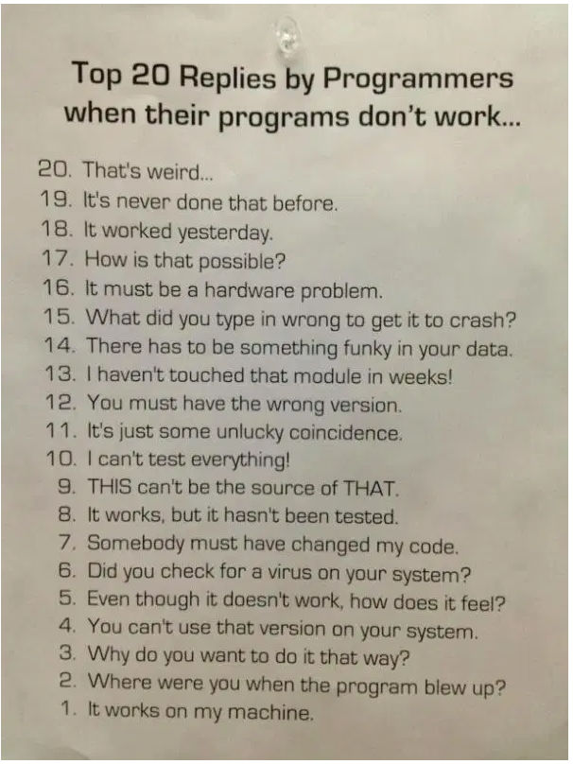
The holy grail of copy paste ☺

Slide 3

Agenda
Why data standards?
A deep dive into CDISC library
Biotech maturity level
Beyond study programming
Ecosystem interpretation
Standards library implementation plan
Manual vs Automation flow
Challenges & Roadblocks
Benefits
Summary

Slide 4
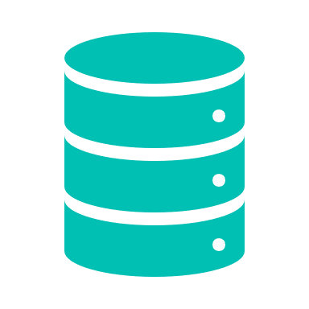
Why data standards?
Efficiency
Traceability
Innovation
Streamline
Data sharing
Reduced costs
Predictability
Data quality
Level 1
Inconsistency
Level 2
Program level consistency
Level 3
Corporate level consistency
Level 4
Vendor level consistency
Notes:
Over the last decade, the clinical research industry has attempted to work towards a common data standard with the goal of accelerating drug development
It is widely understood that standards significantly improve data collection, transformation, analysis, and submission process
Enable companies to harness the power of legacy data with efficient harmonization
Help derive meaningful insights in a timely manner
Consistency in data design across studies (Integrated summaries, FDA response)
Automation of specifications (Study level, Therapeutic level)
Automation of transformations (CDASH->SDTM, SDTM ->ADAM)
Higher transparency in study level submissions
Despite several advantages, the industry-wide adoption of standards has been slow, reactive and riddled with challenges

Slide 5
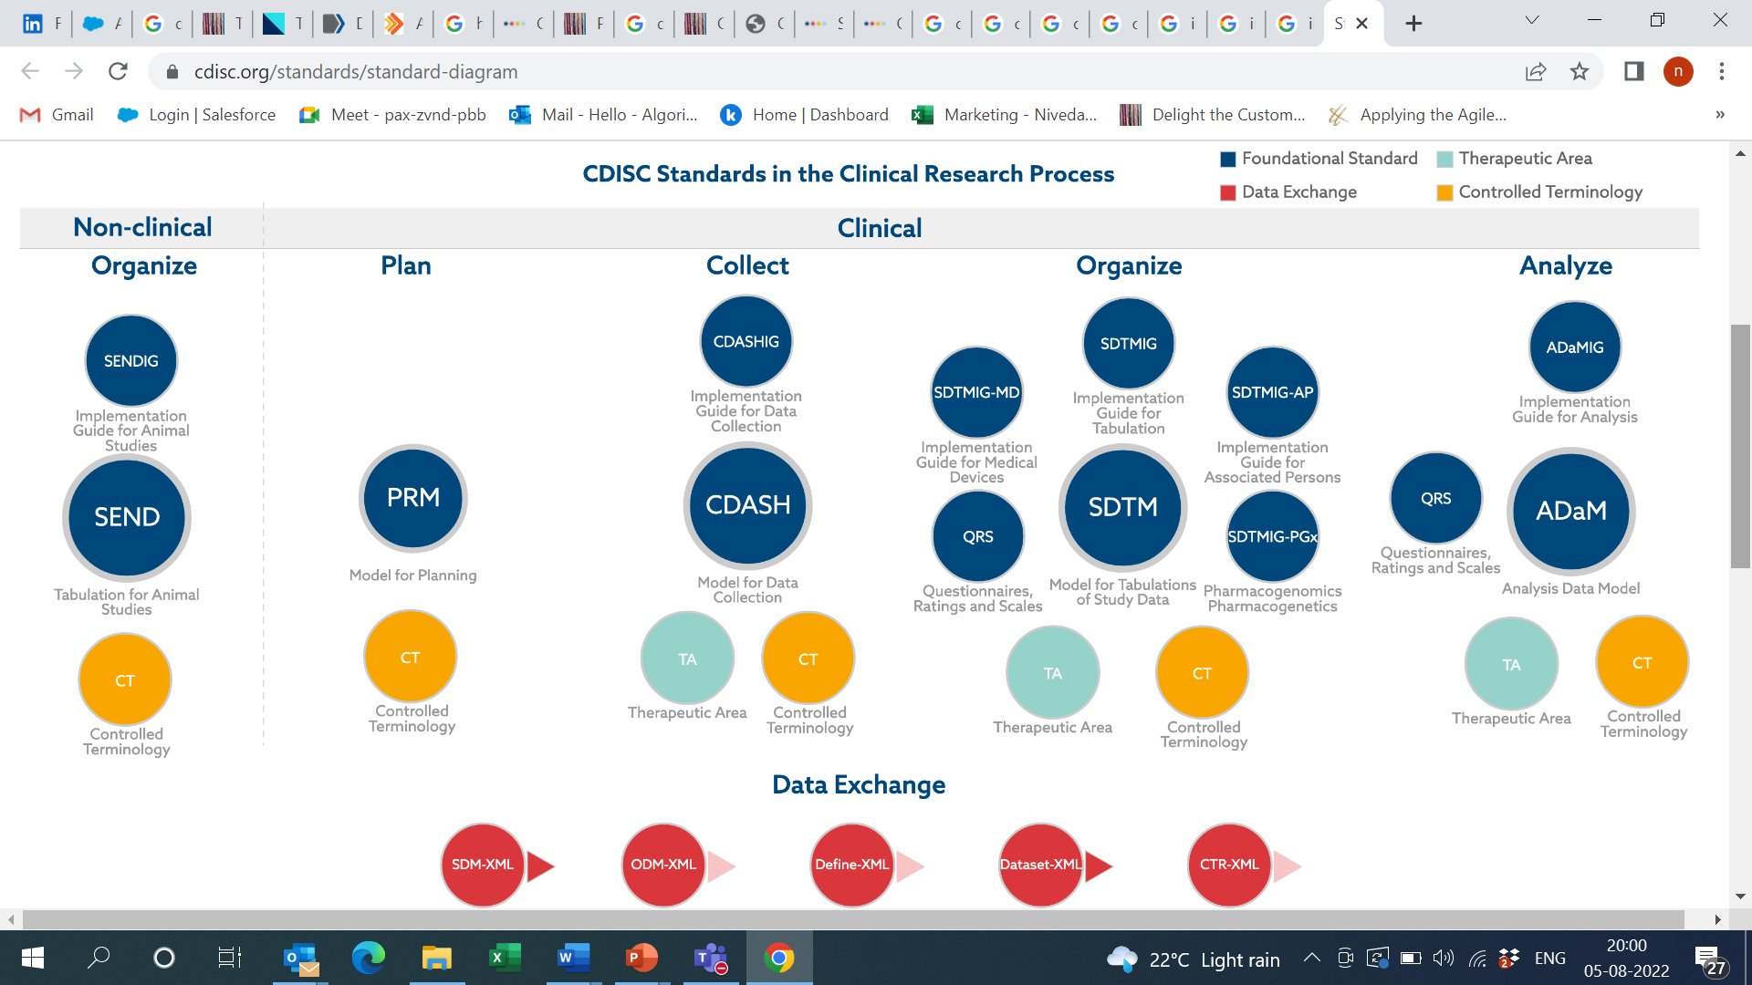
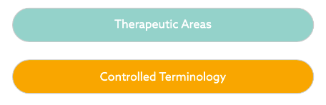
CDISC data standards

Slide 6
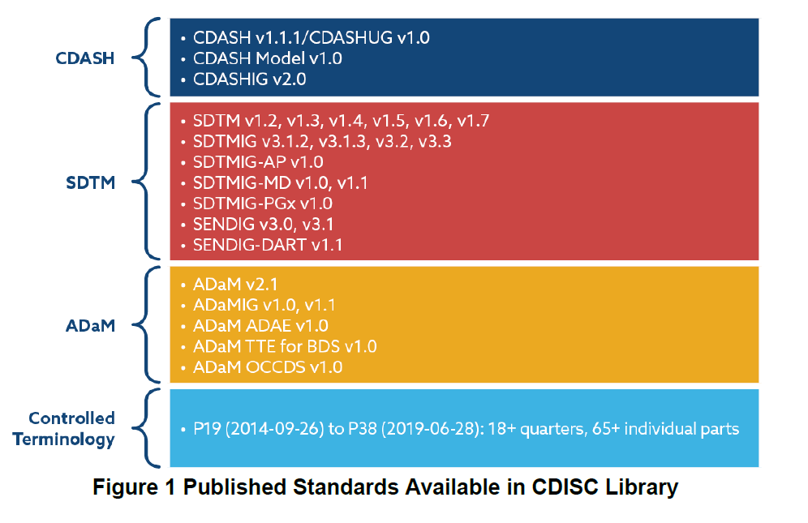
A deep dive into CDISC library
Version based standards
Complete Metadata
Controlled terminology
RESTful API
Data standards browser and search
Implementation guides (IGs)
Traceability and Lineage
Continuous improvement
Data mapping (CDASH – SDTM)
Regulatory support statements

Slide 7

Large biopharma Vs Emerging biotech
Data standards preparedness
Large biopharma | Emerging biotech
Generally, area ahead of the curve in adopting data standards Have implemented, standardized standards across portfolios Are building therapeutic area-focused libraries Engaging teams which ensure maintenance across portfolios | Much smaller and focused product portfolios Investing in implementing, building, and maintaining libraries is considered resource intensive Have small or no teams to support this Assume that partners should have in-house data standards expertise or (CRO, technology partner, or consultant)
Biotech Maturity Levels
Level 1
Fully outsourced to a CRO
Level 2
1–2-member team and planning to scale
Level 3
10+ standards team and working with CROs for few projects
Level 4
Full-fledged data standards department

Slide 8
Beyond study programming
Transparency
        - No more “hidden” descriptions in languages others don’t understand
        - Not only do it but describe exactly how you did it
        Or, better yet, describe how you are going to do it
Consistency
- Across studies in structure, values and derivation logic
e-Submissions – e.g., define files
Data aggregation
Our data standards implementation will help you take both views – the study and beyond the study
- Standards should Enable you rather than constrain you

Slide 9
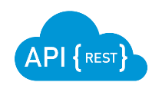
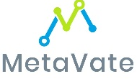

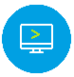

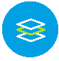
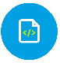


Ecosystem interpretation
Workspace
Audit trial
Version control
Access control
SCE
Metadata driven automation
Data transformation engine
Transparency for define
Data standards compliance
Supports 3rd party data
Scalability across standards
Data anonymization
Standards repository
Manage standards
Manage CTI
Reuse standards
Change impact review
Reuse content
Compliance
MDR
Data flow
automation
Inhouse
Macro library
Automation of repeat tasks
Global macros and study specific macros

Slide 10
Implementation Roadmap
Populate metadata
Verification
Standards compliance
Metadata design
Enrich metadata
Automation
Publication

Slide 11
Components needed
Metadata design
Metadata flow
Metadata management
Process & Compliance
Data state standards
Data flow standards
Automation, which is a primary advantage of standards

Slide 12
Metadata Design
A standard single metadata design
- A standard list of data attributes
- Put in a standard database design optimized for programmatic access
- That can be used for all data standards, study data specifications, third-party data
specifications, etc.
- But also, SID – Study Information Data – to describe study characteristics, like SoE,
visits/epochs, treatment arms, study design, etc.

Slide 13
Metadata flow
Metadata flow underlies data flow
- Each data state is described by database metadata
- Each flow from a source data state to a target data state is described by map metadata.
- This separation is important, it separates “what” from “how” and minimizes impact of changes.
- Any data flow can be represented, including alternate sources to the same target.

Slide 14
Metadata Management
A metadata management system
- A true (meta)database that optimizes programmatic access
- Import mechanisms from CDISC SHARE, NCI and RAVE
- Publication formats to optimize review and approval
- Study metadata creation from standards and other studies
- Enables all sorts of data specifications, not only standards

Slide 15
Process & Compliance
Process
- For data standards and for data specifications
- SOPs, guidance
- Training
- Metrics and compliance measures
- Programmatically generated to reports and a metrics database
measuring compliance, areas of repeated problem, usage rates.

Slide 16
Data state standards
Define WHAT the data state looks like, not how to create it from a source
CDASH extract
Raw
SDTM
ADaM
Define xml file metadata standard
Custom standards
Third-party data, such as lab data

Slide 17
Data Flow Standards
Defines how to create the target data state from a source data state, not what the data state looks like
If the data flow changes over time, there is less impact on metadata content when map metadata is separated from database metadata

Slide 18
Manual study level workflow
Protocol
CRF
Spec
Draft
Cut2
Cut3
Final
Define.
xml
Develop
Draft
Cut2
Cut3
Final
xpt
SDTM
Spec
Validate Develop
ADAM
Define.
xml
Draft
Cut2
Cut3
Final
Spec
xpt
Validate Develop
SAP
TFLs
Final
Draft
Cut2
Cut3
Shells
Pinnacle 21 Validation
Validate

Slide 19
One project level transformation
FPI
Interval 1
Interval 2
Interval 3
Final
Protocol
V1.3
Protocol
V1.0
Raw /
CDASH
Raw /
CDASH
Raw /
CDASH
Raw /
CDASH
Raw /
CDASH
CRF
Spec V1.3
CRF
Spec V1.0
SDTM
SDTM
Spec v1.3
SDTM
Spec v1.0
SDTM
SDTM
SDTM
SDTM
ADAM
Spec v1.3
ADAM
Spec v1.0
ADaM
ADaM
ADaM
ADaM
ADaM
SAP
Shells v1.3
SAP
Shells v1.0

Slide 20

What can go wrong?
Protocol amendments
Data level issues
Tight resource
Resource attrition
Copy paste code from previous study
P21 throwing errors with define.xml at the end of the study
Protocol
V1.1
Protocol
V1.1
Protocol
V1.2
Protocol
V1.3
CRF
Spec V1.1
CRF
Spec V1.1
CRF
Spec V1.2
CRF
Spec V1.3
SDTM
Spec v1.1
SDTM
Spec v1.1
SDTM
Spec v1.2
SDTM
Spec v1.3
ADAM
Spec v1.1
ADAM
Spec v1.1
ADAM
Spec v1.2
ADAM
Spec v1.3
SAP shells
v1.1
SAP shells
v1.1
SAP
shells v1.2
SAP shells
Spec v1.3

Slide 21
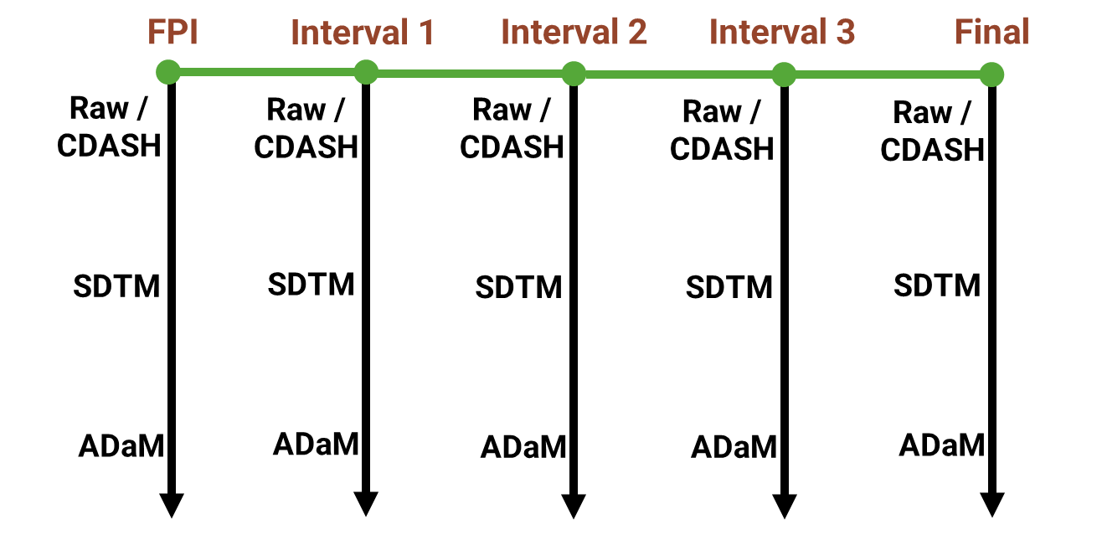
Data transformations at portfolio level

Slide 22
Automation based flow
-> Workflow managed using metadata driven %macros ->
Global Data Standards Metadata
Validate Study Data
eSubmission
Study Metadata Subset
Create Study Data
Study Metadata Subset
Validate Study Data
Create Study Data
eSubmission

Slide 23
CDISC 360 – Roadmap
Metadata for different data states should be scalable with consistent design and not bespoke

Slide 24
Challenges encountered in setting up data standards
Lack of resources
Dedicated expert resources for building and maintenance
Constant evolution
Changing data solutions landscape
(SCE, MDR, CDR)
Standards can be a moving target
Versions change, controlled terminology is frequently updated, different TAs,
and implementation styles change
Loss of time
Setting data standards up when studies are already on-going
Adoption issues
Implementation and conformance across all CRO and data partners

Slide 25

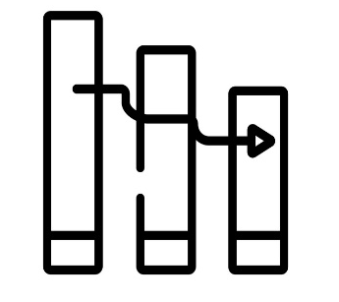
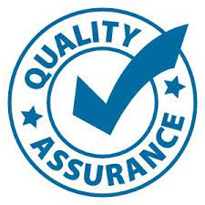

Industry problem
Talent shortage
Challenge to onboard skilled experienced resources
Resource Attrition
Institutional knowledge gets impacted due to lack of continuity
CRO Outputs still verified independently by Sponsor
Regulatory deadlines can be demanding
Silo teams and projects built over time
Disparate process, systems, tools and macros

Slide 26
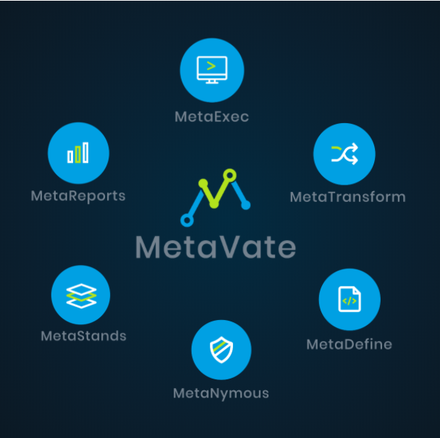
MetaVate solution
Talent shortage
Revolutionary no code, low code platform
Resource continuity
Data standards library and data transformation macros provided as service
Quality Assurance
100% independent approach compared to double programming
Silos systems and process
Purpose built to unify metadata standards based on CDISC 360
Notes:
One click generation of artifacts
Metadata driven approach builds study intelligence over time
Generates all artifacts needed for regulatory submission
End to end system eliminates the need for additional tools

Slide 27
Productivity gains for a biotech
Organized assets
Change management
Ease of doing due diligence- internally as well as for a potential acquisition
From first spec to final spec, smoother flow of information (impact analysis)
Cost optimization
Integrated summaries
Ease of delivering integrated summaries to the FDA when numerous studies are involved
when working with partners and as metadata scale
Output verification
Data reviews
Enhanced ability to verify data quality and output
Improved efficiencies in reviews (multiple re-runs)

Slide 28
Questions?
THANK YOU
FOR
YOUR
ATTENTION
Get in touch:
Nithiya Ananthakrishnan
Chief Executive Officer
(: +1 508 873 6124
*: nithiya@algorics.com
www.algorics.com

