Slide 1




A human-in-loop analytics driven approach for anonymization & redaction of clinical data submissions
Ganes Kesari
August 16, ‘22

Slide 2













Ganes Kesari
Co-founder & Chief Decision Scientist
Solve business problems using insights and stories on a low-code platform
/gkesari
@kesaritweets
100+ Clients
“Simplify Data Science for all”

Slide 3

Anonymizing Clinical Study Reports (CSR) with the right balance of Privacy and Transparency is challenging
Privacy
Transparency
New regulatory requirements such as EMA 0070 and Health Canada PRCI
Specific data privacy guidelines for all reports published in the public domain
These regulations also call for a level of data transparency
Prescribe sufficient data granularity to help the scientific community

Slide 4



Anonymization of CSRs is a three-fold problem
Human Errors
Time consuming & cumbersome process with many complex steps
Error prone and requires multiple manual reviews
Unstructured Content
Regulatory Constraints
No plug & play, off-the shelf Named Entity Recog. models
Requires pharma domain specific entities
Complex and rapidly evolving regulations
High quality thresholds with stringent re-identification thresholds

Slide 5




1. Regulatory Constraints: Increasing regulations spike compliance costs and the likely penalties for breaches
Typical annual Spends of $2-3 Mn on external vendor costs
Typical cost of a healthcare breach was $9.2 Mn per incident
Tech advances & public data spike re-identification risks
84% increase in healthcare data breaches, impacting 45 million people
IBM Report - Cost of a Data breach
Notes:
Errors could result in law-suits with liabilities running into millions of dollars
Delays could risk penalties of $0.3 mn monthly
Depending on scale, spend of
$2-3 mn pa in external vendor costs are incurred in addition to internal Org costs
Technological tools and access to public domain databases has opened new risks of adversarial re-identification of anonymized data.
Healthcare breaches cost the most by far, at $9.23 million per incident – a $2 million increase over the previous year.
The cost of a breach was $750,000 higher than average at organizations that had not undergone any digital transformation
https://newsroom.ibm.com/2021-07-28-IBM-Report-Cost-of-a-Data-Breach-Hits-Record-High-During-Pandemic
A 2021 study by Critical Insight using HHS info found that from 2018 to 2021, there was an 84% increase in the number of data breaches against healthcare organizations. When it came to the number of total victims, the figure jumped from 14 million in 2018 to 44.9 million in 202

Slide 6



2. Human Errors: Clinical teams go through a long and cumbersome process for CSR anonymization
25+ complex steps in achieving anonymization using different clinical trial management systems
Higher potential for error with data flowing across multiple internal systems, databases and emails for reviews and approvals
Time consuming processes with cycle times up to 45 days for each summary document

Slide 7


3. Unstructured Content: Advanced analytics and Natural Language Processing is needed to extract PII entities with high accuracy
NLP
Anonymization
Data anonymization is the process of transforming information by removing or encrypting sensitive data (PII or PHI), in order to protect data subjects’ privacy and confidentiality
Process of transforming and understanding human language to identify meaningful patterns and new insights
NLP Techniques:
Information Retrieval
Natural Language Processing
Information extraction (NER- Named entity recognition)
Anonymization Techniques:
Character Masking
Pseudonymisation
Generalization
Swapping
Data perturbation etc

Slide 8
The Solution: A measured approach which balances human validation and judgement with analytics and automation
Human-in-the Loop
User-centered solution design
Collaborative workflows with user feedback
Advanced Analytics
Regulatory Compliance
Leveraged open-source tech
Custom algorithm training for better domain understanding
Domain experts helped tailor algorithms for unstructured data
Strong & scalable solution capabilities basis past experience
Regulatory & research community help understand required quality thresholds
Iterative optimization till the desired EMA and Health Canada controls were met

Slide 9
The Anonymization Solution handles structured and unstructured data with iterative risk scoring to ensure compliance
Reference population (data on similar trials)
Unstructured Data Transformation
Parsing CSR docs
Entity recognition
Sampling for users to validate
Recall calculation
User Input
CSR documents
Structured data transformation
Iterative risk scoring and optimization algorithm
Final risk adjusted CSR document

Slide 10
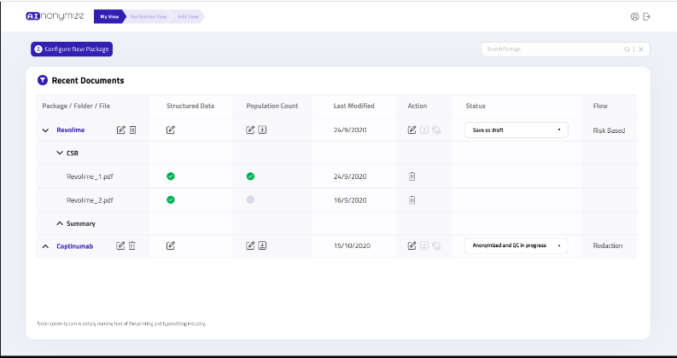
Here’s a sneak-peek of the Anonymization Solution
Live Solution Demo

Slide 11
What did we learn from implementing such solutions for clients?
Be prepared to tackle a variety of input data sources in terms of document structure, style, and entities
Typical CSRs contain 100+ tables and figures which need to be treated as independent problems
Paucity of research on the risk of reidentification and patient privacy in pharma clinical space

Slide 12



Where are we headed? Solutions must be geared for more attacks, tightening regulations, and regional variations
Data breaches have become more easy
World regulations are evolving & norms are being tightened
Region specific variations of regulations are emerging

Slide 13

Please share your session feedback!
Open the URL: Menti.com
Use the code : 2129 8313
Thank You!
Ganes Kesari
/gkesari
@kesaritweets
www.gramener.com

