Slide 1

Natural Language Processing for Automated Classification of Qualitative Data From Interviews of Patients With Cancer
Chao Fang, Natasha Markuzon*, Nikunj Patel, Juan-David Rueda
*To whom the correspondence should be addressed: natasha.markuzon@astrazeneca.com
Published online on July 12, 2022 in Value in Health:
https://www.sciencedirect.com/science/article/pii/S109830152202040X

Slide 2


Opportunity
Patient centricity is core to AstraZeneca’s Growth Through Innovation strategy and throughout medical product development and delivery
Patient engagement is critical to understand how they feel, function, and survive due to their disease and treatment through qualitative patient interview research
Cancer patients often experience:
    significant symptom burden
    worsened quality of life
    prospect of shorter survival
Unmet needs:
  Evaluate and understand cancer patient experience more efficiently and effectively to inform patient-centered endpoints and product development
  Automate qualitative coding to decrease inter-observer biases
  Scale to larger population of clinical trial patients
Image source: Google Image at public domain

Slide 3
Motivation
Currently performed manually by the vendor
  Takes a lot of time, error prone
  Strongly dependent on processing style by the vendor
  Expensive and labor-intensive process
  Interview that takes an hour to conduct may take several hours to get processed
  Quotations have a large degree of length variance

Slide 4
Objective
Develop AI/NLP as a potential tool for improving the analysis of unstructured qualitative patient reported data.
  Employed several novel AI/NLP methods such as word embedding, RNN, BERT methods to accurately predict symptom, impact related description.
Extract information from free format text that is of interest to caregivers and payers.
  Identify important key words such as: text describing symptoms and quality of life of patients to interpret the prediction results

Slide 5
Experimental Dataset
Sample of HCC patient interview transcript :
...
Where do you currently live, what state?
We live in the state of Delaware.
...
Did you have any pain in your stomach associated with that?
No, and I would say to my husband…and this would come and go, I would bend over and sometimes I would get a sharp pain. I’m thinking, okay, well, what is this? But it wasn’t all the time so I couldn’t identify that the pain was there all the time, it was just coming and going. And we just had so much going on at that time that…sometimes life gets in the way of realizing what’s actually going on.
...
For two weeks, when you have Y90, you can’t be around other people because you’re radioactive, literally.
...
100 1-hr long IQVIA cleaned interview transcripts
Type of cancer dataset:
  Hepatocellular carcinoma (HCC)
  Biliary tract cancer (BTC)
  Gastric cancer (GC)
“Question” part from interviewers and “Answer” part by patients
  Conversation is colloquial reflecting the patients voice and potentially limited medical background

Slide 6
Problem formulation
...
Where do you currently live, what state?
We live in the state of Delaware.
...
Did you have any pain in your stomach associated with that?
No, and I would say to my husband…and… This would come and go, I would bend over and sometimes I would get a sharp pain. I’m thinking, okay, well, what is this? But it wasn’t all the time so I couldn’t identify that the pain was there all the time, it was just coming and going. And we just had so much going on at that time that…sometimes life gets in the way of realizing what’s actually going on.
...
For two weeks, when you have Y90, you can’t be around other people because you’re radioactive, literally.
...
Input: a paragraph (sentences from patient interview
Output: predicted labels (either “Symptom”, “Impact”, “Other”)
Associated labels:
Symptom
Demographics
Impact
Less Meaningful

Slide 7
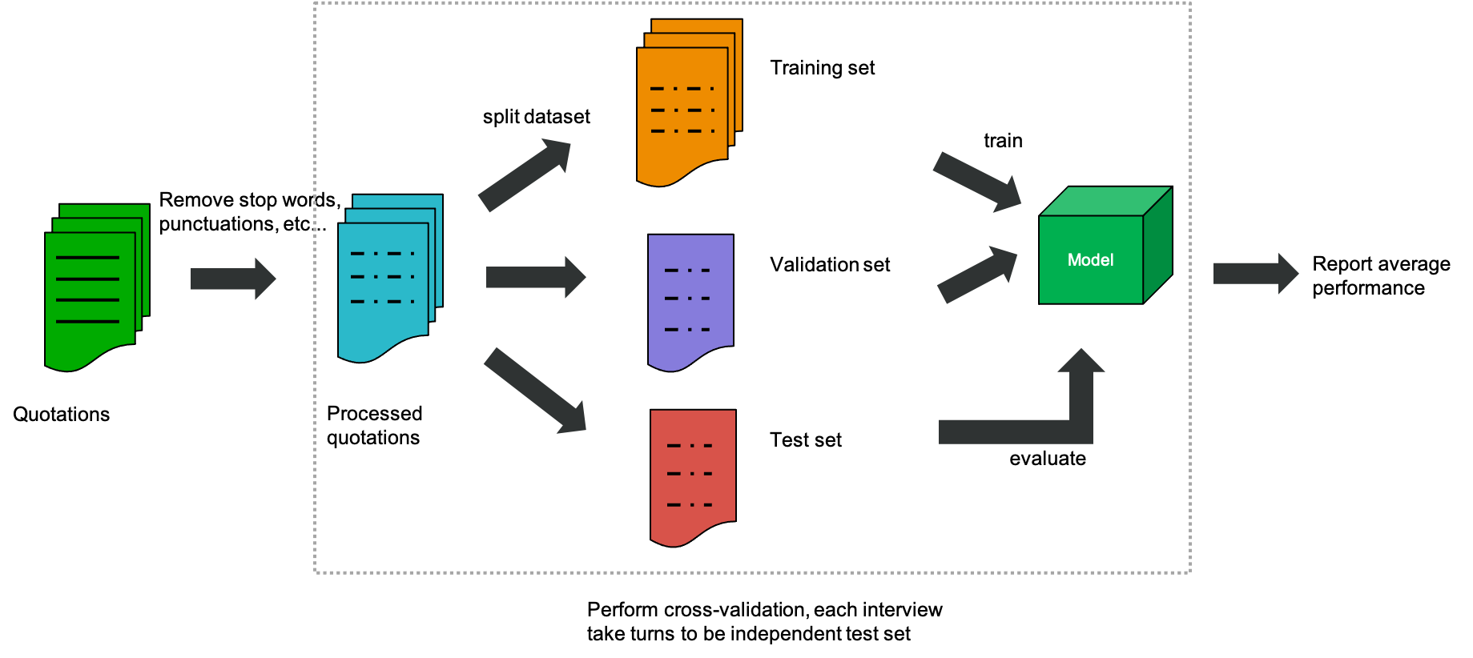
Applications of ML/NLP model for Symptom, Impact, Other multi-class labeling
Transfer sentences to vectors

Slide 8
Brief summary of all methods
Word frequency-based approach highlighting word importance within a document:
  TF-IDF
Contextual based methods: Taking co-occurrence of words and global text interrelations into account:
  GloVe (Pennington et al., 2014) word embedding approach
  RNN models: LSTM (Gers., et al, 1999), GRU (Chung et al, 2014)
Transfer learning: incorporating models trained on large corpus to local problem
  Original BERT (Devlin et al., 2018) model was pretrained by large dataset using Wikipedia.
  Adapt the pretrained BERT model to the patient interview dataset
  Has built-in capability allowing interpret the prediction

Slide 9
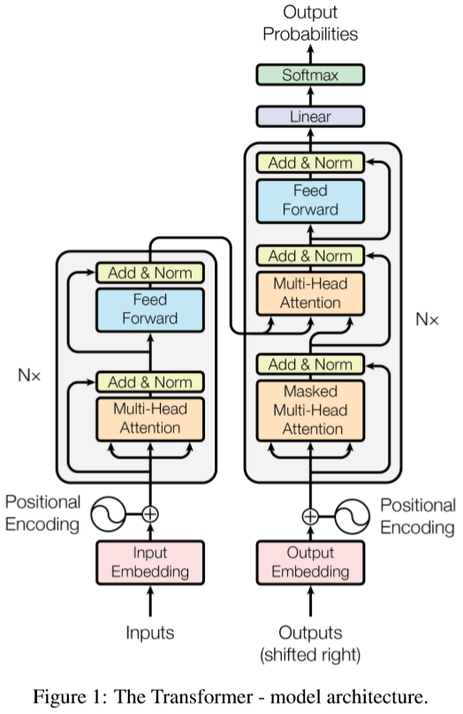
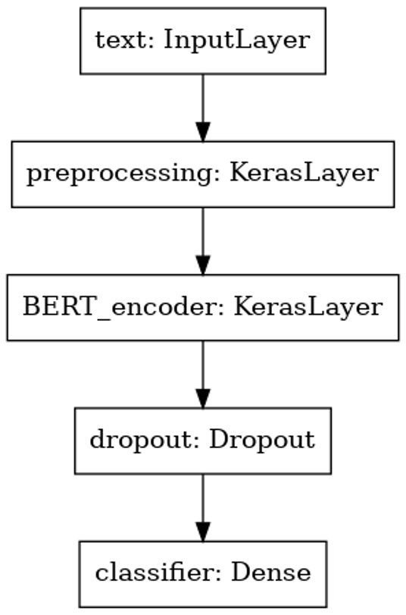
BERT model for multi-class (Symptom, Impact, Other) prediction
Decoder
Preprocessing:
Transform text input to numeric token ids and arranged in several Tensors before being input to BERT (input_words_id, input_mask, input_type_ids)
Encoder
BERT_encoder:
small_bert/bert_en_uncased_L-6_H-128_A-2
Hyperparameters:
  L=6 hidden layers
  H=128 hidden size
  A=2 attention heads
Reference:
https://www.tensorflow.org/tutorials/text/classify_text_with_bert
“Bert: Pre-training of deep bidirectional transformers for language understanding” Devlin et al., 2018

Slide 10
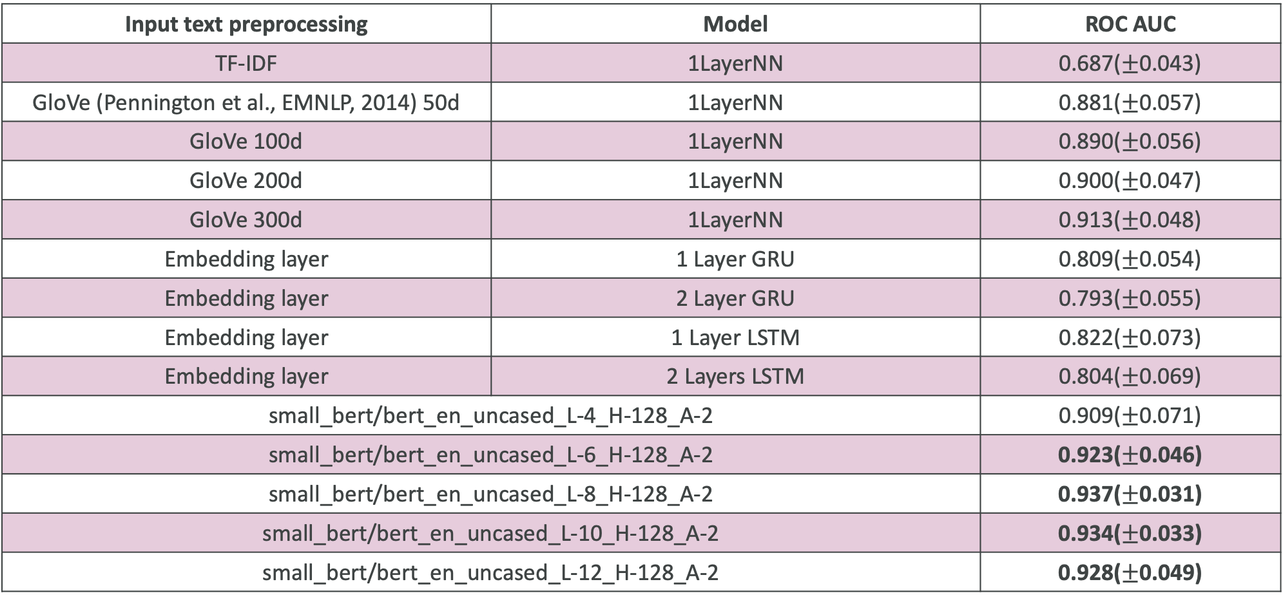
Performance comparison across different models using HCC dataset on multi-class classification task
Input text preprocessing | Model | ROC AUC
TF-IDF | 1LayerNN | 0.687($±$0.043)
GloVe (Pennington et al., EMNLP, 2014) 50d | 1LayerNN | 0.881($±$0.057)
GloVe 100d | 1LayerNN | 0.890($±$0.056)
GloVe 200d | 1LayerNN | 0.900($±$0.047)
GloVe 300d | 1LayerNN | 0.913($±$0.048)
Embedding layer | 1 Layer GRU | 0.809($±$0.054)
Embedding layer | 2 Layer GRU | 0.793($±$0.055)
Embedding layer | 1 Layer LSTM | 0.822($±$0.073)
Embedding layer | 2 Layers LSTM | 0.804($±$0.069)
small_bert/bert_en_uncased_L-4_H-128_A-2 |  | 0.909($±$0.071)
small_bert/bert_en_uncased_L-6_H-128_A-2 |  | 0.923($±$0.046)
small_bert/bert_en_uncased_L-8_H-128_A-2 |  | 0.937($±$0.031)
small_bert/bert_en_uncased_L-10_H-128_A-2 |  | 0.934($±$0.033)
small_bert/bert_en_uncased_L-12_H-128_A-2 |  | 0.928($±$0.049)

Slide 11
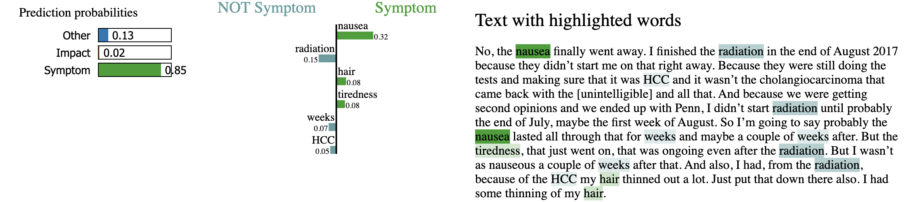
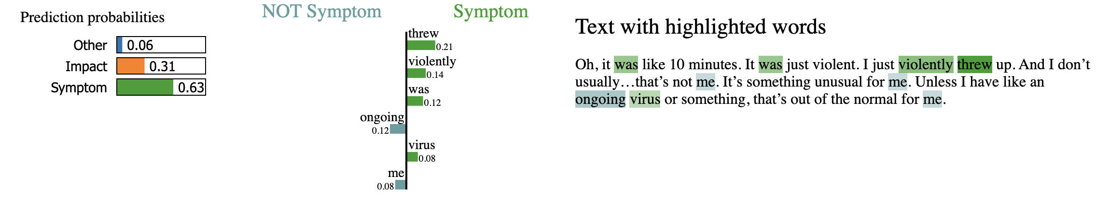
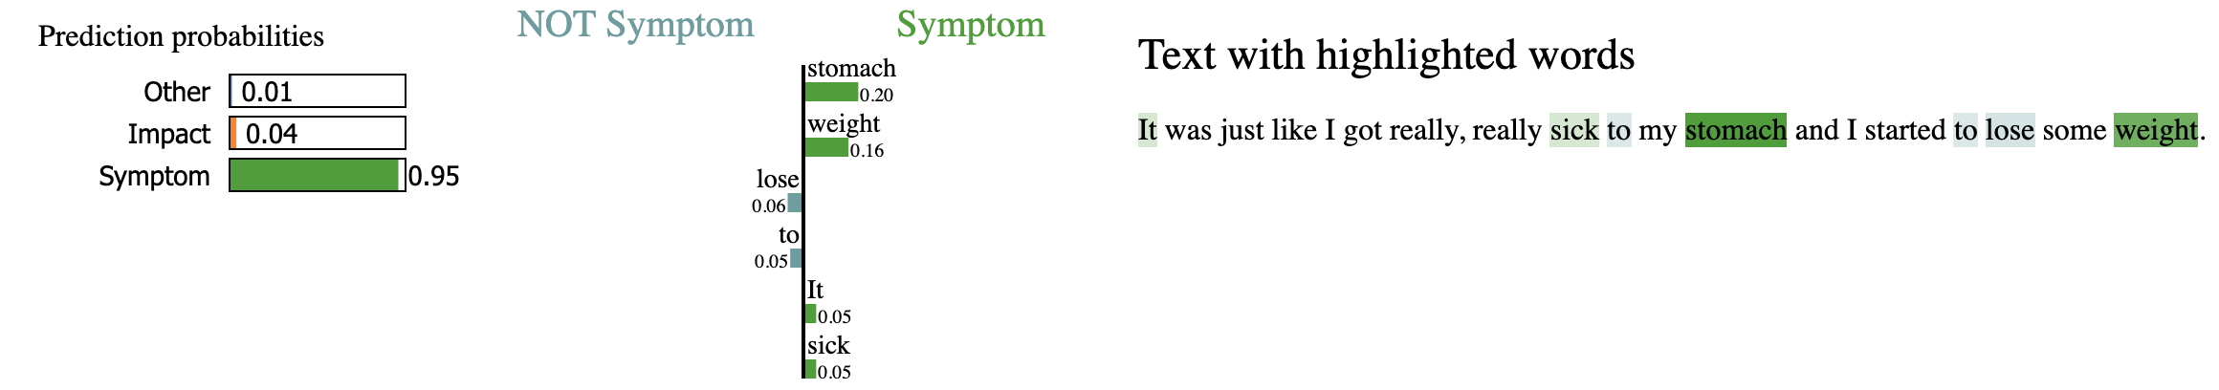
Examples of highly ranked predictors for Symptoms

Slide 12
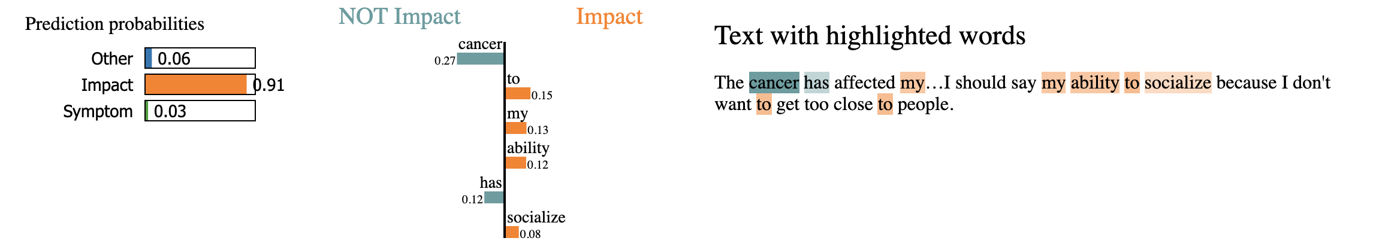
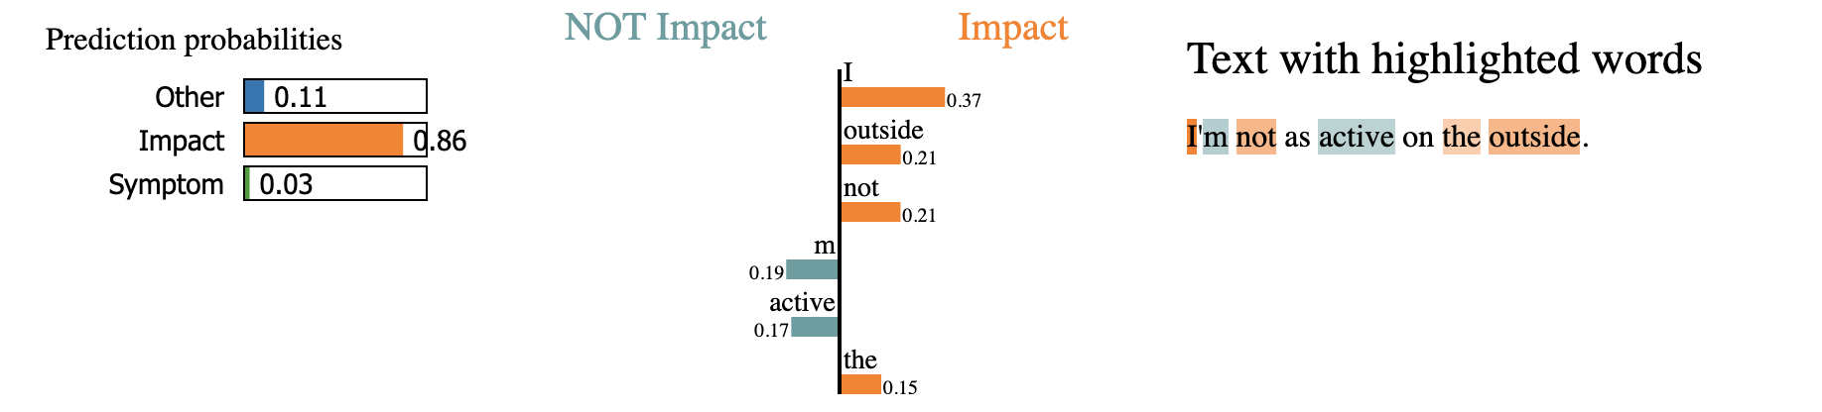
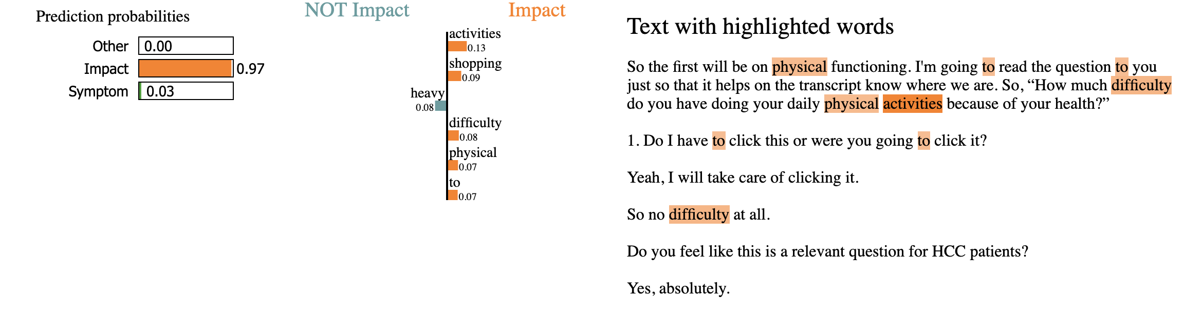
Examples of highly ranked predictors for Impact on Life

Slide 13
Conclusion
Developed proof of concept models for unstructured patient interview analysis
  Evaluated NLP as a potential tool for interview processing improvement
Demonstrated advantages of automated ML information extraction in this context
  Evaluated a suit of algorithms
  Developed ML-driven tagging approach
  Achieved good accuracy on the evaluation set
Introduced methods for model interpretation
  Automatically extracted information that contributes positively/negatively towards prediction

