Slide 1





PhUSE SDE – Boston 2022
Tools to Solutions: Use of AI/ML to Support Automation
www.geninvo.com
North America | UK | Europe | India

Slide 2

What We’ll Cover…
Current state of AI in Life Sciences
AI-enabled applications in LS
Tools vs. Solutions
How AI can help to convert a “Tool” into a “Solution”

Slide 3
Current State

Slide 4

Current State of AI in Life Sciences
In an online article, “AI in Life Sciences Trends and Terms that Executives Need to Know”, June 19, 2018 by Raghav Bharadwaj (https://www.techemergence.com/ai-in-life-sciences-trends-and-terms/), executives were asked to identify AI trends in the industry. Results were as follows:
The time and associated costs of drug discovery and development has the pharma sector at the frontier of AI-integration
Industry leaders are looking to AI technology to improve efficiency and save costs
With uncertainty as to how to incorporate AI professionals into the LS workforce, startups continue to surface and are either partnering with or being acquired by bigger pharma companies
AI adoption is a certainty, and those who use it most effectively will gain competitive advantage
Notes:
But I’ve seen similar claims of ~80 of C-level professionals considering AI to be a competitive advantage and consequently a key to their company’s success.

Slide 5
AI-Enabled Applications

Slide 6
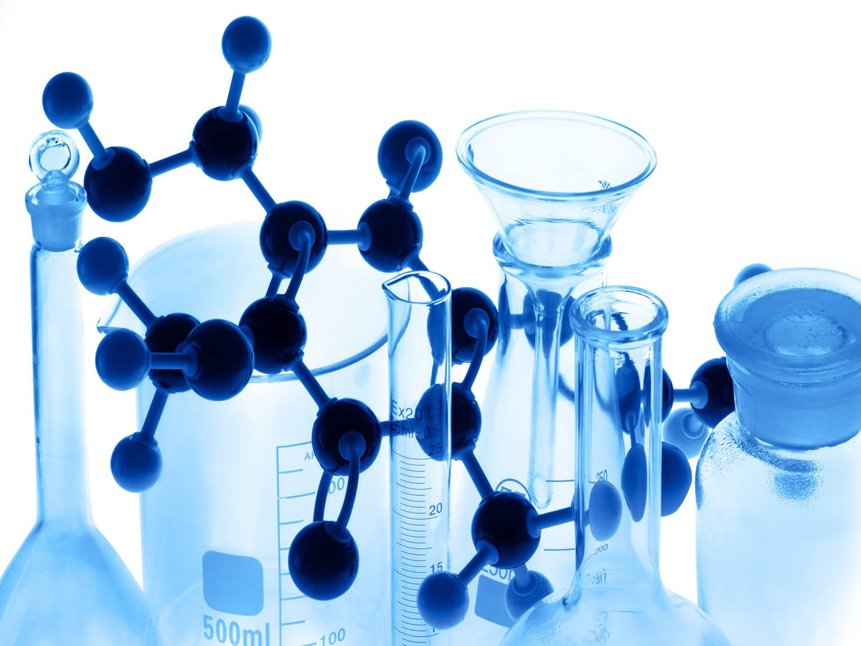
AI-Enabled Applications in Life Sciences
AI has already been used in drug discovery in a number of ways^{[1]}…
  Computer-aided synthesis
  Computer-assisted retrosynthesis based on molecular similarity
  Organic synthesis and design
  Scoring synthetic complexity
  Automation of molecule design
  Predicting organic reaction outcomes
  Predicting drug performance in testing
  Discovering off-label use
  Predicting toxicity prior to clinical trials
  Personalized medicine
Notes:
Pulled this from https://www.psychologytoday.com/us/blog/the-future-brain/201807/how-artificial-intelligence-is-accelerating-life-sciences

Slide 7
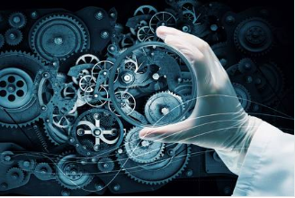
AI-Enabled Applications in Life Sciences (cont’d)
AI is used in drug discovery in a number of ways^{[1]}...(cont’d)
Neural networks to predict the binding of small molecules to proteins, thereby accelerating the drug discovery process. Enables the analysis of 10 to 20 billion chemical compounds daily, reducing the time for discovery and optimization process from years to weeks.
AI-driven drug discovery platforms to identify in vivo testing with predictive technology.
Generative Adversarial Networks (GANs) for new molecule drug discovery, biomarker development, and aging research.
Notes:
Pulled this from https://www.psychologytoday.com/us/blog/the-future-brain/201807/how-artificial-intelligence-is-accelerating-life-sciences

Slide 8
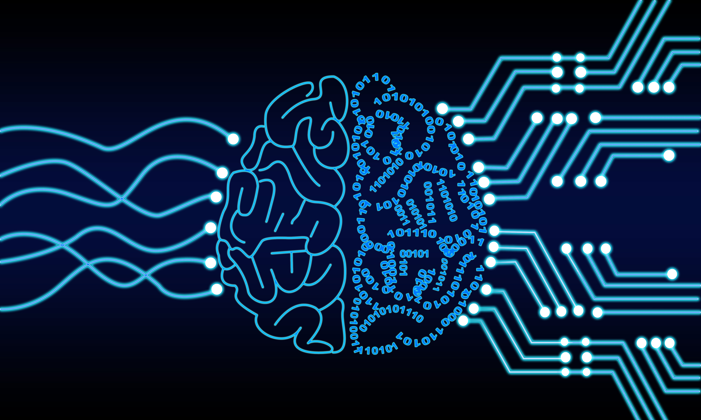
AI-Enabled Applications in Life Sciences (cont’d)
AI is also being adopted in the data management and biometrics areas...
  Generation of standard datasets with ability to facilitate transformations based on metadata
  Outlier detection based on combination of variables at the time of data collection at sites. Ability to detect odd/extreme values is enhanced as data are passed through the ML models.
  QC of documents (e.g., CSR) using an automated tool to reduce cycle times and enhance quality
  Anonymization of datasets and documents using pre-defined strategies while optimizing the balance between re-identification risks and data utility using ML
Notes:
Pulled this from https://www.psychologytoday.com/us/blog/the-future-brain/201807/how-artificial-intelligence-is-accelerating-life-sciences

Slide 9
Tools vs. Solutions

Slide 10
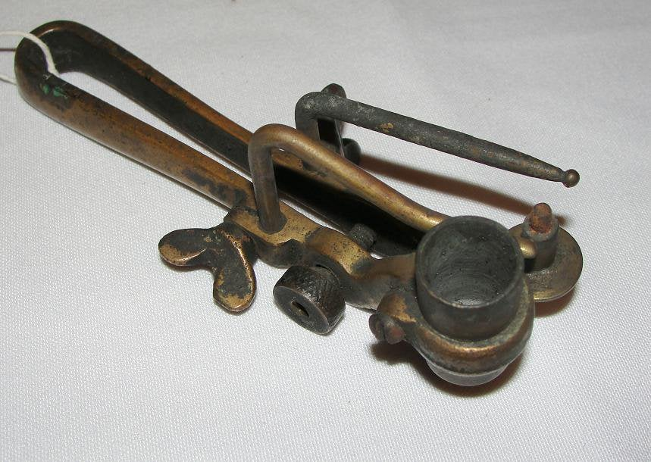

Tools vs. Solutions
What’s this thing?

Slide 11
Tools vs. Solutions (cont’d)
 | Tool | Solution
Focus | Specific task | Desired outcome inclusive of all related steps/tasks
Key to Successful Outcome | Relies on the expertise of the user wielding the tool | Learns from successfully completed projects
Level of Automation | Depends on APIs and ability to configure and integrate with other systems | Applies learnings to propose logical processes/next-steps/plan and leverages the plan to lead the user to the desired outcome
Change Management | Typically, easier to implement | Typically, has greater impact to existing processes/people

Slide 12
How AI Can Help Convert Tools to Solutions

Slide 13
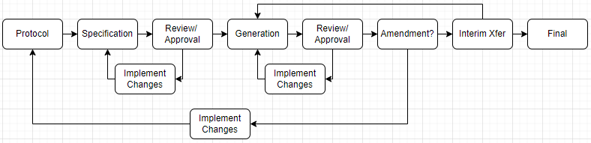
How AI Can Help Convert Tools to Solutions
For example, an artifact generation platform. Fairly common process flow for generating any type of biometrics deliverable is as follows:
Notes:
This process focuses on ensuring quality by working off of the protocol to generate specifications which are then used to generate both source and validation outputs. The latter are then compared and accuracy confirmed prior to review by the extended team. There are multiple review cycles of mostly a manual nature, specifications are prone to error due to manual review and entry, and it’s a very time consuming process.

Slide 14

How AI Can Help Convert Tools to Solutions (cont’d)
Enhancements:
Recommender System to generate plan based on project parameters
Intelligent Workflow Tool to facilitate the plan/process (taking into content and statuses)
Protocol Scraper (NLP) to generate specification

Slide 15

How AI Can Help Convert Tools to Solutions (cont’d)
Enhancements:
Workflow Tool to engage the collaborative Review/Approval cycle (collecting feedback to use for model enhancement and recording metrics to assess quality) and initiating updates to spec as needed

Slide 16

How AI Can Help Convert Tools to Solutions (cont’d)
Enhancements:
Workflow Tool engages the artifact generation process leveraging the specification populated by the protocol and automapping of raw-to-standard structural and transformational metadata
Workflow Tool subsequently engages team in a review/approval cycle

Slide 17

How AI Can Help Convert Tools to Solutions (cont’d)
Enhancements:
Workflow Tool evaluates requests for amendments and interim transfers and engages the necessary processes through final deliverable

Slide 18
How AI Can Help Convert Tools to Solutions (cont’d)
Process Deficiency | Proposed Solution
Manual generation of the project plan | Recommender system can generate default plans leveraging other similar and successfully completed projects
Manual review/scraping of the protocol | ML Models for scraping facilitate the generation of the specifications directly (using other similar projects and data)
Manual review/ approval processes | Workflow and model-based QC tools can be used to help automate QC processes and collection of any findings
Inadequate real-time support | Intelligent Chatbots that become increasingly capable due to feedback of its users, and not just in sharing information, but helping the user through their question and to reengaging them with the workflow

Slide 19
How AI Can Help Convert Tools to Solutions (cont’d)
Other Automations | Notes
Ongoing Model Training | Reinforcement training from completed projects. Incorporation of QC review feedback for further enhancements (WITH MODEL ADMINISTRATION CAPABILITIES).
System Integrations | Integrations with Active Directory for SSO, with data/document repositories to work with data in place. With these integrations, implementation of the solution can be managed through the interface/configuration panel lessening the impact of traditional on-prem implementation methods.
Recommender Systems and Workflows | Lead user through the process to the desired outcome. Workflows can be configured to match existing processes to once again minimize impact.
Push-Button | Solution/platform can ultimately be made to operate in background, notifying team members when reviews are needed, etc.

Slide 20
Summary

Slide 21
Summary
AI has gained additional momentum over the last 4 years.
More-established data science teams in collaboration with development teams/partners have been able to generate more sophisticated tools in drug discovery, biometrics, and medical writing.
Tools vs. Solutions: Majority of users want to know how the job is getting completed while also having the ability to view/change the manner by which it is getting completed. However, rather than a tool or collection of tools, users are looking for increased automation. “Lead me to the correct result and give me the opportunity to course-correct as needed.”
Data Science and AI make this next-level “hyper” automation possible.

Slide 22
  Ideas
  Delivered
  Intuitively
Thank You!
+1-855-GENINVO (436-4686) | info@geninvo.com | www.geninvo.com

