Slide 1

Not net neutral:
data science, technology, ethics, and social impact
Barbara E. Bierer, MD
Professor of Medicine, Harvard Medical School
Faculty Director, MRCT Center of BWH & Harvard
bbierer@bwh.harvard.edu
PHUSE August 23, 2022

Slide 2

Disclaimer and Conflicts
  The views and findings expressed are those of the speaker (and others) and do not imply endorsement or reflect the views or policies of the U.S. Food and Drug Administration or the affiliated organization or entity of any member who contributed to the work of the MRCT Center. Individuals served in their individual capacity.
The MRCT Center is supported by voluntary contributions (www.MRCTCenter.org) and grants, one of which is from Johnson and Johnson. I have been a consultant to Eli Lilly in the last 24 months, and I am on the BOD of Clinithink Inc.
I have no personal conflicts of interest to disclose relevant to this work.
And thank you for inviting me

Slide 3

The Multi-Regional Clinical Trials Center (MRCT Center)
Our Vision
Improve the integrity, safety, and rigor of global clinical trials.
Our Mission
Engage diverse stakeholders to define emerging issues in global clinical trials and to create and implement ethical, actionable, and practical solutions.

Slide 4
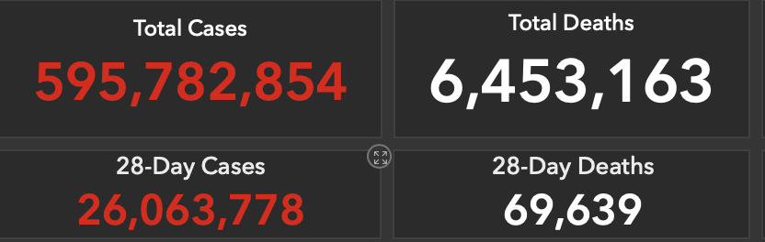
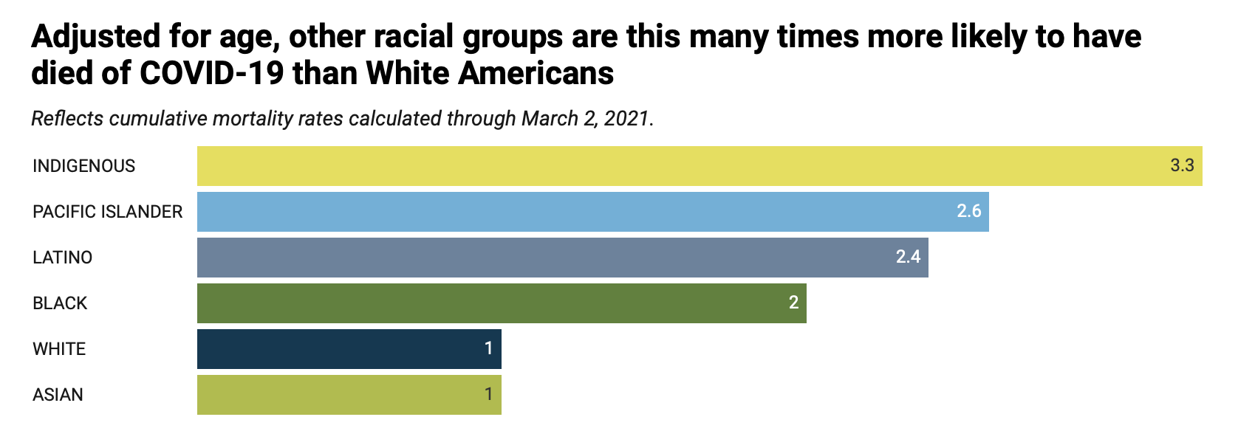
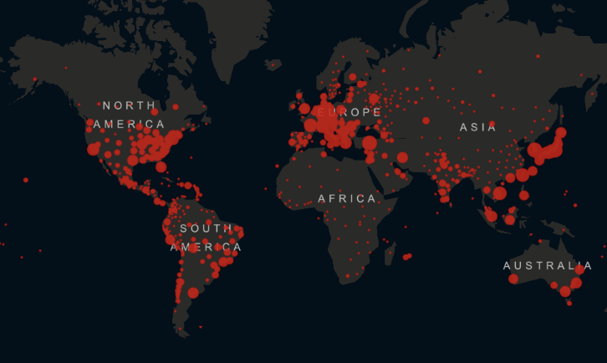
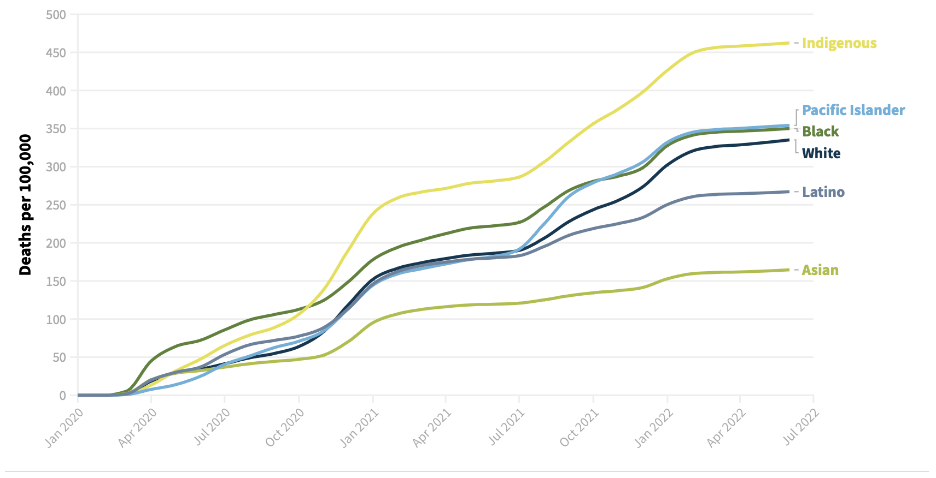
COVID-19 pandemic focused health disparities worldwide
https://www.apmresearchlab.org/covid/deaths-by-race
August 10, 2022
April 27, 2022
https://coronavirus.jhu.edu/data

Slide 5
.
The importance of diversity and inclusion in clinical research
Analyses of group differences in outcome among diverse populations can promote identification of underlying biological and socially relevant factors that affect health, but only if data exist.
Diversity in enrollment seeks fairness in the distribution of direct and long-term benefits of research.
Diverse representation is not simply a matter of biology, but a matter of health equity and fairness.
Participation helps build public trust in research and healthcare.

Slide 6
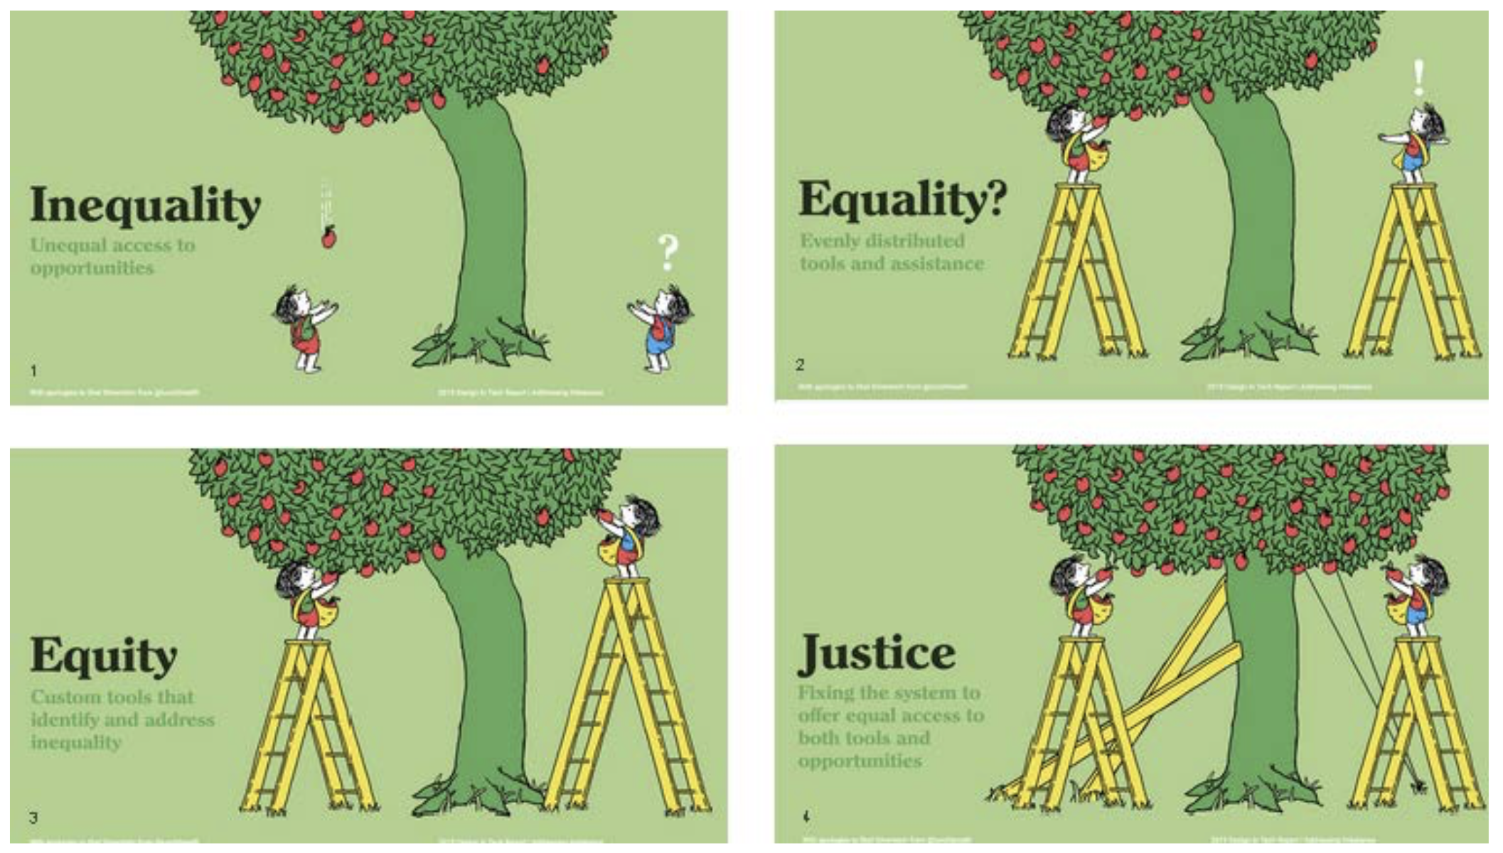
Focus on diversity, inclusion, equity and justice: Definitions
Diversity: the quality of being different. Definitions of diversity can be broad: age, race sex, gender identity, social determinants of health, co-morbidities, etc.
https://www.paperpinecone.com/blog/teaching-difference-between-equality-equity-and-justice-preschool
© MRCT Center Confidential Do not share. Do not duplicate.
Notes:
6
Note that we shorten to DEI

Slide 7
Focus on diversity, inclusion, equity and justice: Definitions
Diversity: the quality of being different. Definitions of diversity can be broad: age, race sex, gender identity, social determinants of health, co-morbidities, etc.
Inclusion: the action or state of including or of being included within a group or structure. Individuals are treated fairly and respectfully, have equal access to opportunities and resources, and can contribute fully
https://www.paperpinecone.com/blog/teaching-difference-between-equality-equity-and-justice-preschool
© MRCT Center Confidential Do not share. Do not duplicate.
Notes:
7
Note that we shorten to DEI

Slide 8
Focus on diversity, inclusion, equity and justice: Definitions
Diversity: the quality of being different. Definitions of diversity can be broad: age, race sex, gender identity, social determinants of health, co-morbidities, etc.
Inclusion: the action or state of including or of being included within a group or structure. Individuals are treated fairly and respectfully, have equal access to opportunities and resources, and can contribute fully
Equity: the quality of being fair and impartial. Equity is a state.
https://www.paperpinecone.com/blog/teaching-difference-between-equality-equity-and-justice-preschool
© MRCT Center Confidential Do not share. Do not duplicate.
Notes:
8
Note that we shorten to DEI

Slide 9
Focus on diversity, inclusion, equity and justice: Definitions
Diversity: the quality of being different. Definitions of diversity can be broad: age, race sex, gender identity, social determinants of health, co-morbidities, etc.
Inclusion: the action or state of including or of being included within a group or structure. Individuals are treated fairly and respectfully, have equal access to opportunities and resources, and can contribute fully
Equity: the quality of being fair and impartial. Equity is a state.
Justice: the maintenance and administration of what is just by the impartial adjustment of conflicting claims of the assignment of rewards or punishments
https://www.paperpinecone.com/blog/teaching-difference-between-equality-equity-and-justice-preschool
And belonging Inclusive Excellence
© MRCT Center Confidential Do not share. Do not duplicate.
Notes:
9
Note that we shorten to DEI

Slide 10
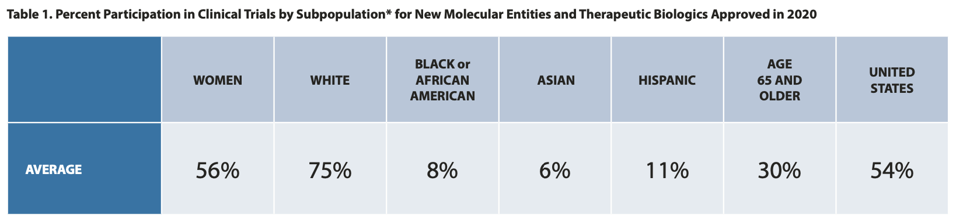
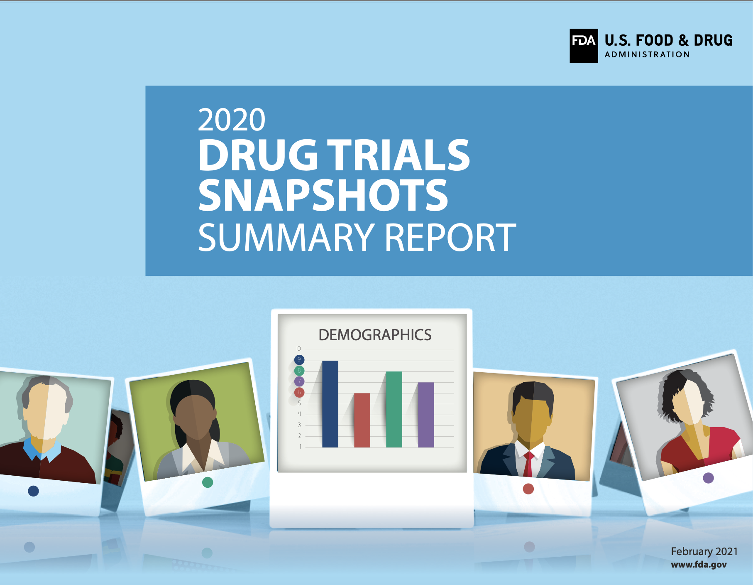
Application to clinical research
Diversity (#)
Inclusion Were an equal number of individuals, from each group and each subgroup, invited to participate in the trials?
Equity Were all individuals provided the support that they needed to consider participation?
Justice Did all prospective participants have an opportunity to express what they needed, how they wished to be engaged, and how the research would be conducted? Did it impact health equity? Had the underlying structural issues been addressed?
https://www.fda.gov/ media/145718/download

Slide 11
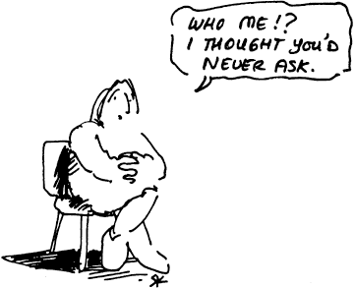
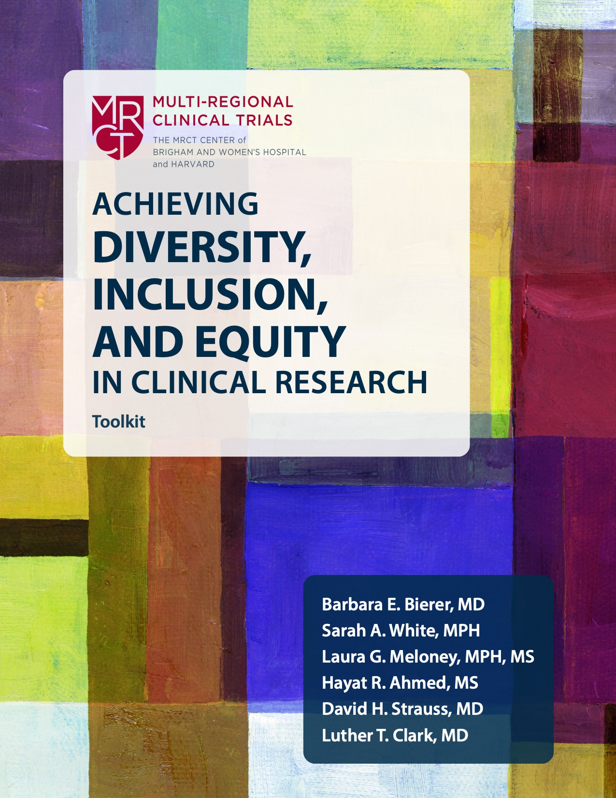

Achieving Diversity, Inclusion, Equity In Clinical Research
https://mrctcenter.org/diversity-in-clinical-trials/
© MRCT Center Confidential

Slide 12
Planning for inclusion throughout the patient journey
Every touch-point has impact
Early Interventions
End of Study, Data Analysis, and Reporting
Study Conduct
Recruitment
Informed consent: Participant on study
Participant Last visit:
End of study treatment
End of trial
LPLV
Data Analysis Complete and Reporting
Access
Data
Lock
Screening
On-Study visits
On study:
Additional testing
Randomization
Follow-up period
Awareness

Slide 13







Current landscape and challenges
RCTs long, complex, expensive, and getting worse
  Randomization minimizes bias
  Highly selective population
    Defined inclusion criteria
    Defined exclusion criteria
    Often minimizing co-morbidities
    Restrictive use of medications other than investigational products
  Data collected with high fidelity, quality, and integrity
    Source documentation
  Statistical plan and analytics pre-defined
Protection of Vulnerable Populations
Protection
Inclusion
How does this relate to the real world setting, clinical and medical practice, and health care delivery?

Slide 14
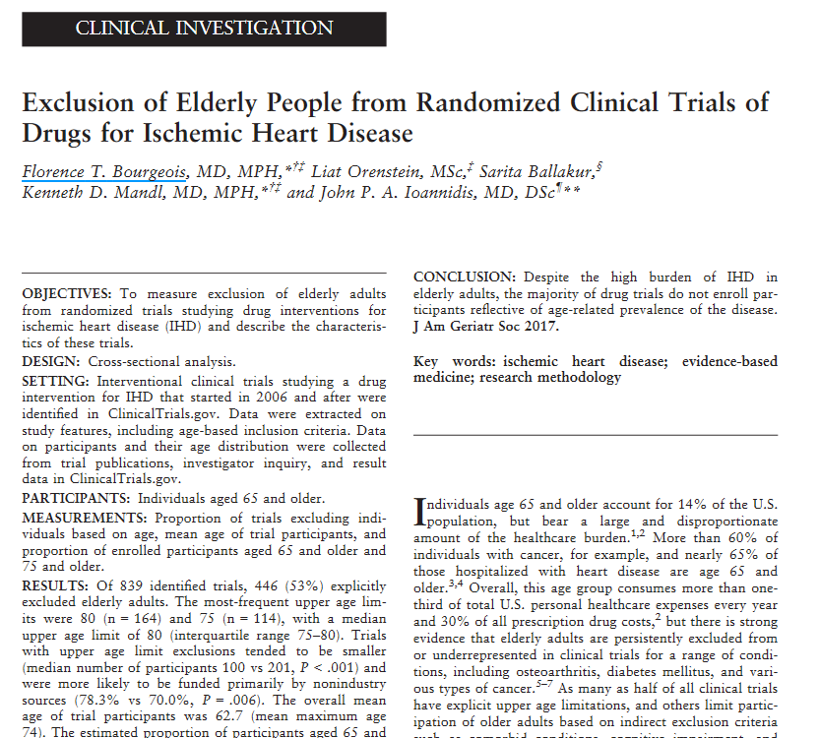
High risk groups and underrepresented populations often excluded from clinical trials: Applicability therefore limited
Of 839 identified trials, 446 (53%) explicitly excluded elderly adults.
Other exclusion criteria included comorbid conditions, cognitive impairment and polypharmacy

Slide 15
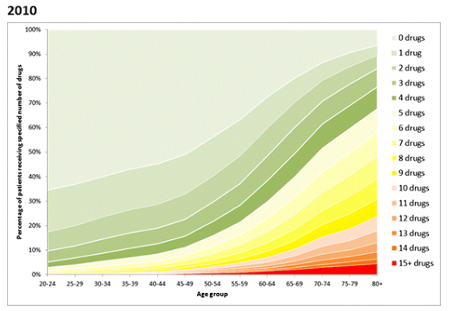
RCTs fail to include individuals with concomitant medications: applicability therefore limited
Receipt of ≥10 drugs was very strongly associated with increasing age
50% of those aged 70yrs received 6 or more medicines.
24% of aged >80 received 10 or more medicines
Significant increase in polypharmacy over last decade.
Guthrie et al. BMC Medicine (2015) 13:74

Slide 16
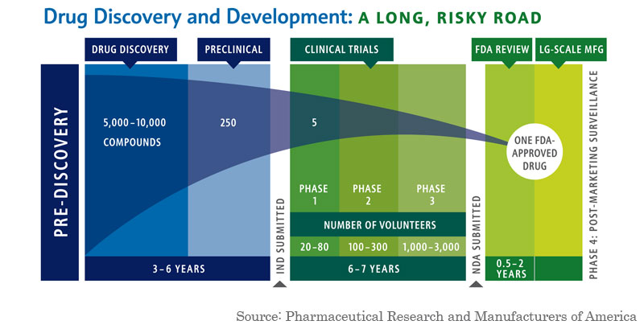
Current drug development paradigm, largely based on RCTs

Slide 17
RCT vs RWE
RCT
Patient benefit and harm in experimental and closely monitored research studies, normally RCTs
Design minimizes bias – high internal validity
Generalizability questionable
  Restricted entry criteria
  Unrepresentative settings
RWE
Patient benefit and harm when the technology is actually applied in everyday practice
Pragmatic clinical trials
Observational studies
Synthesis
“Evidence used for decision-making that is not collected in conventional randomized controlled trials (RCTs)”
“Dirty:” significant variability and biases

Slide 18
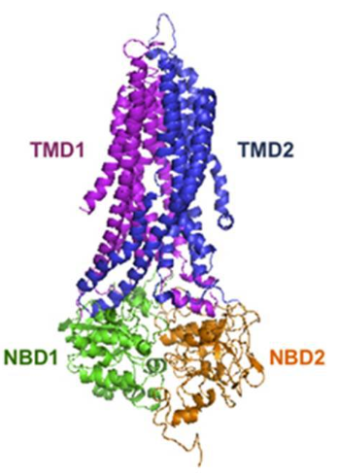
Genomic-Based Mechanism of Action (and even smaller trials)
Smaller, focused RCTs
Cystic Fibrosis (CF) drug, ivacaftor, targets G551D mutation in the CFTR gene (4% of CF population), one of nearly 2000 mutations
Delivers increases in FEV₁ ~10%.
Early studies leading to approval:
Dose ranging: 39 adults
Efficacy: 109 age ≥ 12 years treated (213 enrolled)
Continued, more expansive investigation since, including of other CF mutations
Cost: ~$300,000 year
Kim and Skach,
Front Pharmacol.
2012 Dec 13;3:201
18

Slide 19

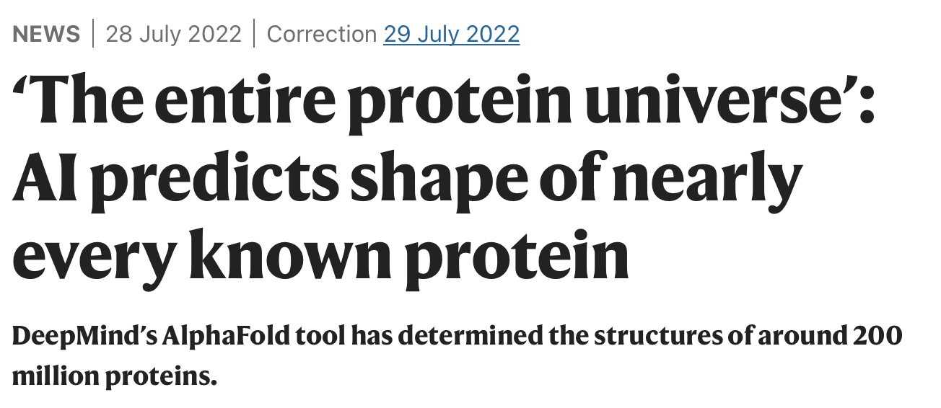
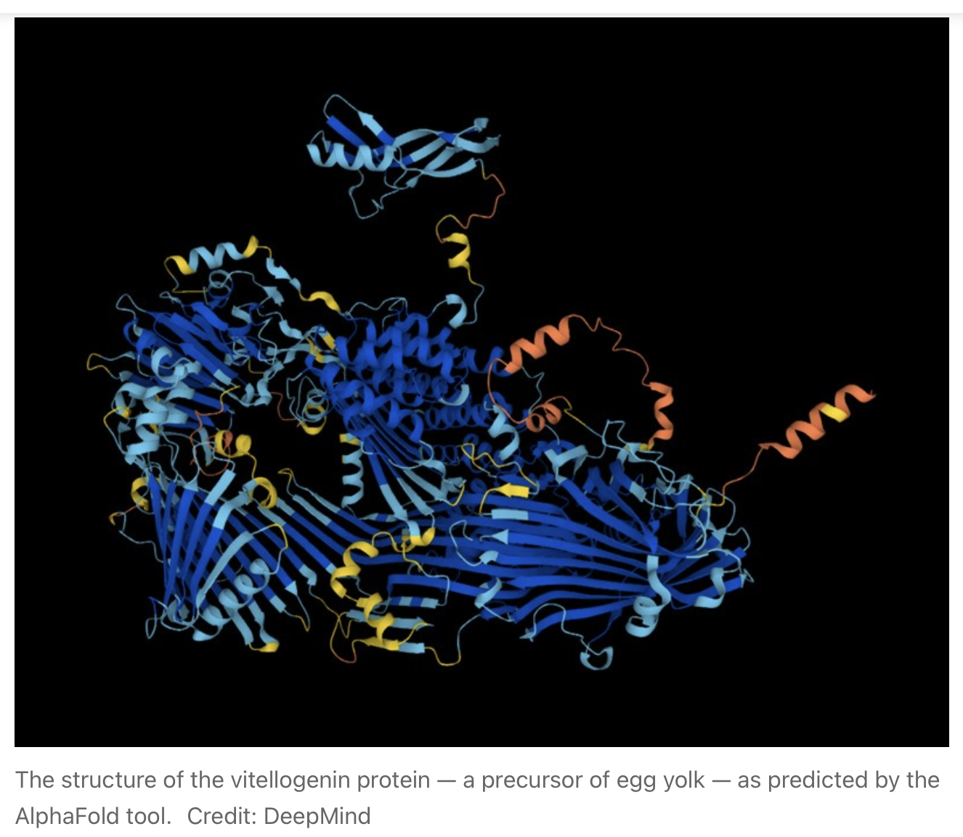
Real world data (RWD) and real-world evidence (RWE)
Medicine is changing
Data is changing
Twenty-three terabytes
https://www.nature.com/articles/d41586-022-02083-2
doi: https://doi.org/10.1038/d41586-022-02083-2

Slide 20

Need better picture than RCTs provide:
Is RWD the answer?
Electronic health records
  Primary care data, hospital records
Patient and caregiver surveys
  Claims data
  Patient Disease Registries
  Patient Cohort Registries
  Product Registries
  Spontaneous AE, SAE Reporting
  Sentinel and other data sources
  PROs, mobile device data
Datasources
  Prescription databases
  Drug utilisation data sources
  Other data sources
Real world data
Data collected outside the constraints of conventional randomised clinical trials.

Slide 21
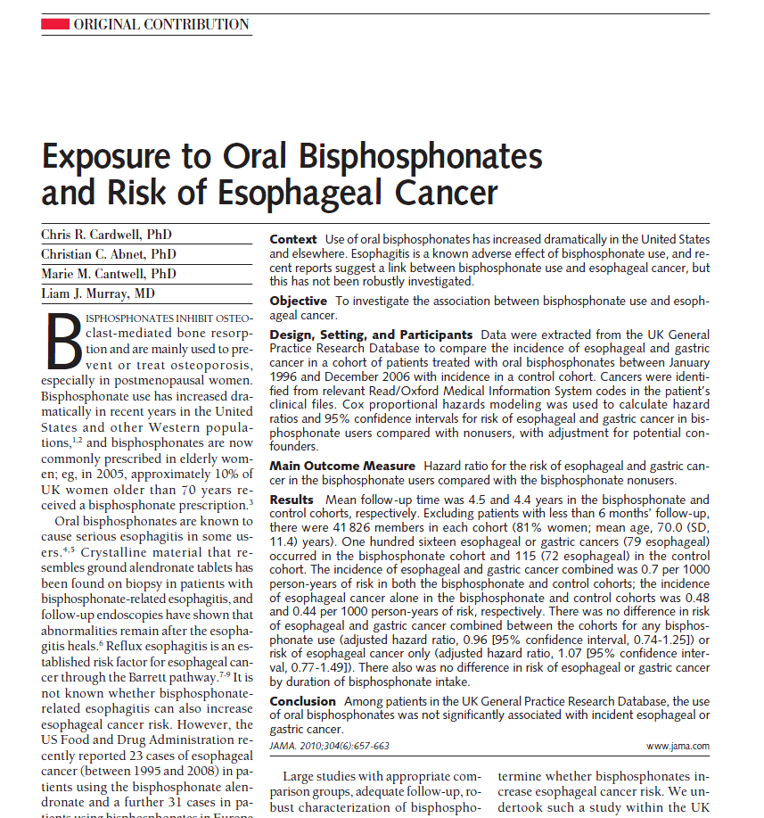
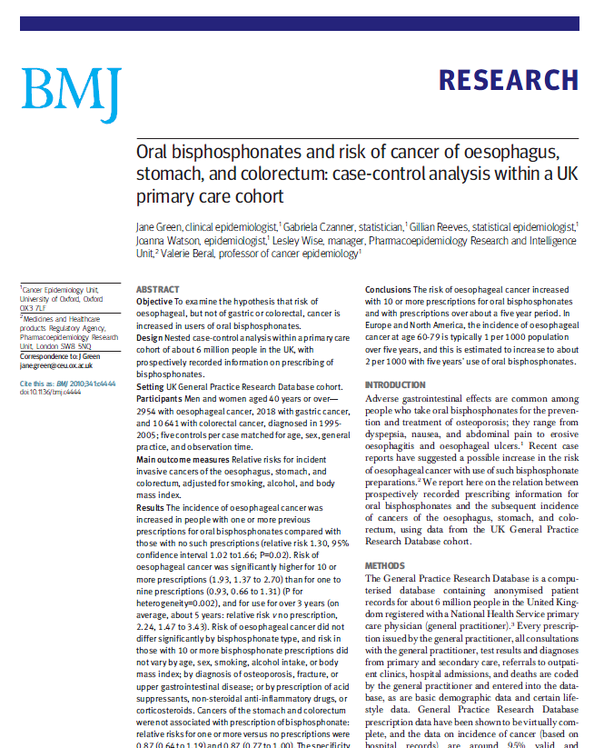
Conflicting results creates uncertainties
August 2010: “the use of oral bisphosphonates was not significantly associated with incident esophageal or gastric cancer”
Sept 2010: “we found a significantly increased risk of oesophageal cancer in people with previous prescriptions for oral bisphosphonates”
Studies utilising the same data source, over the same time period with the same drug of interest and the same outcome delivered opposing results

Slide 22
Top 20 of 5561 descriptions of codeine product dose
The Challenge of Definition and Code Standards
doscode | Frequency | Description | Standard recoding
0000047 | 2492510 | TAKE 1 OR 2 4 TIMES/DAY | 6.00
0021825 | 494909 | TAKE 1 OR 2 FOUR TIMES DAILY | 6.00
0000126 | 421667 | 1-2 FOUR TIMES A DAY WHEN REQUIRED | -1.00
0000098 | 246520 | 2 FOUR TIMES A DAY WHEN REQUIRED | -1.00
0000185 | 237956 | TAKE TWO 4 TIMES/DAY | 8.00
0000201 | 206628 | 1 OR 2 FOUR TIMES A DAY WHEN REQUIRED | -1.00
0000227 | 171983 | 1-2 FOUR TIMES A DAY | 6.00
0000048 | 139230 | TAKE ONE 4 TIMES/DAY | 4.00
0000114 | 138386 | 2 FOUR TIMES A DAY | 8.00
0000034 | 116813 | ONE OR TWO FOUR TIMES A DAY WHEN REQUIRED | -1.00
0016164 | 114705 | 2 TABS 4 TIMES DAILY | 8.00
0000003 | 108314 | AS DIRECTED | -1.00
0000496 | 92268 | TAKE 1 OR 2 4 TIMES/DAY WHEN REQUIRED | -1.00
0000257 | 92250 | TAKE 1 OR 2 3 TIMES/DAY | 4.50
0007812 | 78018 | TAKE ONE OR TWO FOUR TIMES/DAY | 6.00
0001588 | 76761 | TAKE 1 OR 2 EVERY 4-6 HRS | 6.00
0010666 | 76284 | ONE OR TWO TO BE TAKEN UP TO FOUR TIMES A DAY WHEN REQUIRED FOR 'PAIN | -1.00
0000026 | 65854 | TWO FOUR TIMES A DAY WHEN REQUIRED | -1.00
0000021 | 65460 | TAKE ONE TWICE DAILY | 2.00
Identical
Uncodable
6 is the estimate of 1-2 pills 4X/d
25,911 dose descriptors overall in one dataset

Slide 23
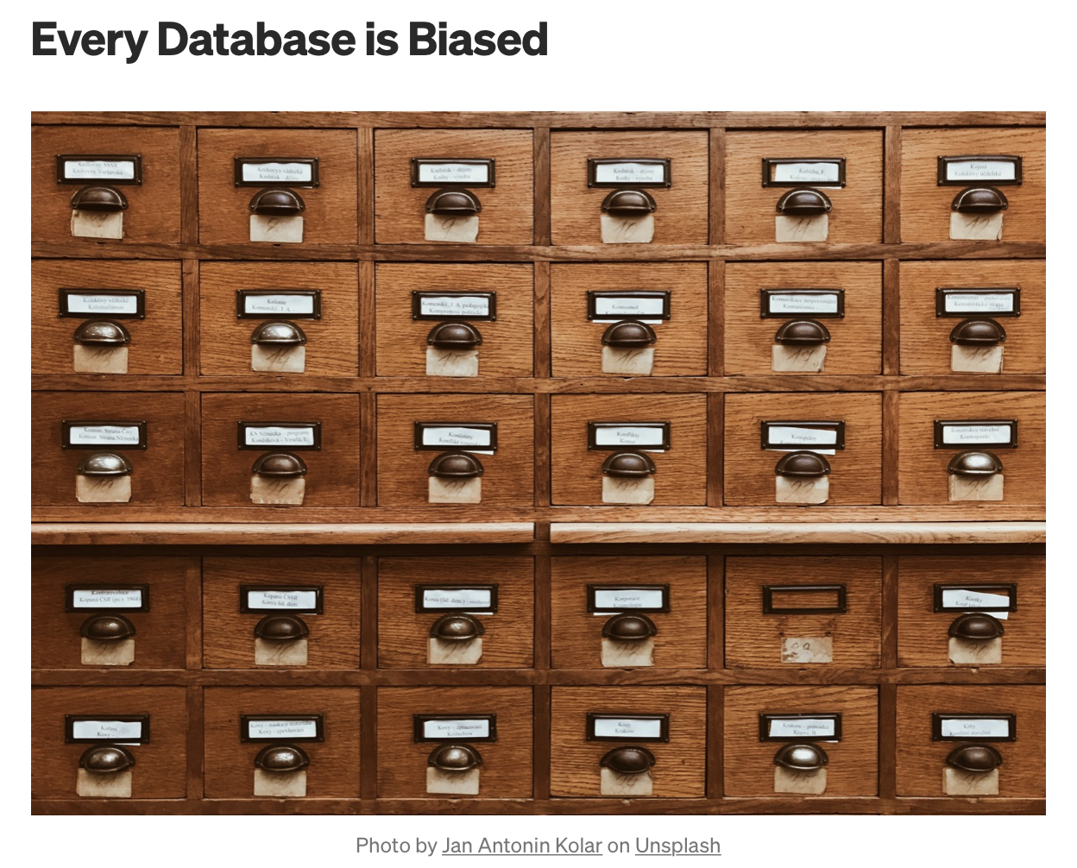
Every database is biased
Understand:
The bias(es) within
Conditions under which data were collected
Data processing and transformation
Data quality and missingness
Embedded assumptions
Provenance of the data
Privacy
Confidentiality
Sensitivity
Use
https://becominghuman.ai/every-database-is-biased-6a402224b8a9

Slide 24
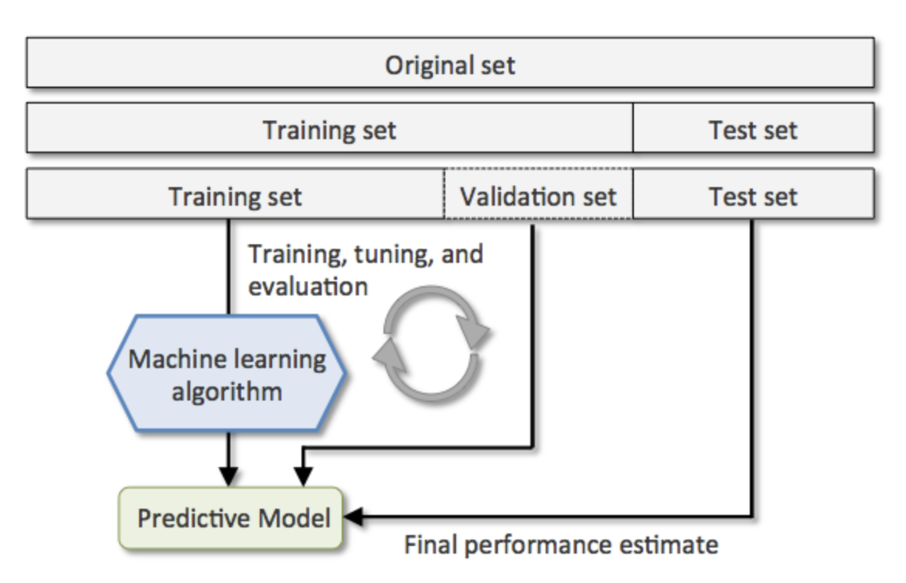
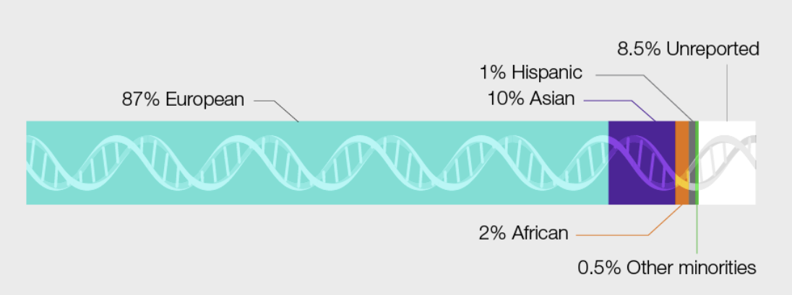
Starting measures
Choice of dataset
Limitations of dataset use
Not (only) a problem of overfitting
But also a problem of bias
Complexity increases with data integration
NHGRI
The 1,000 Genomes Project (2002 - 2015)
Human Heredity and Health in Africa (H3Africa) (2012 - 2022)
Polygenic Risk Score (PRS) Diversity Consortium (2021 - 2027)
Implementing Genomics in Practice (IGNITE) Network (2018 - 2022)
Electronic Medical Records and Genomics (eMERGE) Network (2020 - 2025)
https://www.genome.gov/about-genomics/fact-sheets/Diversity-in-Genomic-Research

Slide 25
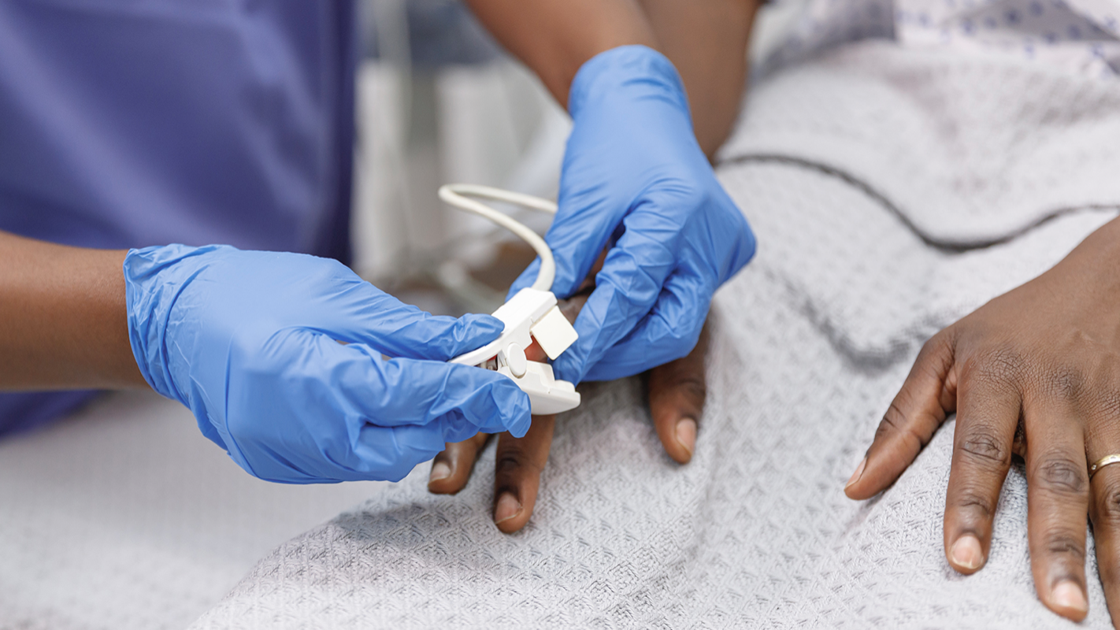
Does it matter?
Example of pulse oximetry
https://hms.harvard.edu/news/skin-tone-pulse-oximetry?utm_source=Silverpop&utm_medium=email&utm_term=field_news_item_2&utm_content=HMNews08182022&utm_source=AcousticMailing&utm_medium=email&utm_campaign=HMNews_071822%20(1)&utm_content=HMNews_0718_2022

Slide 26
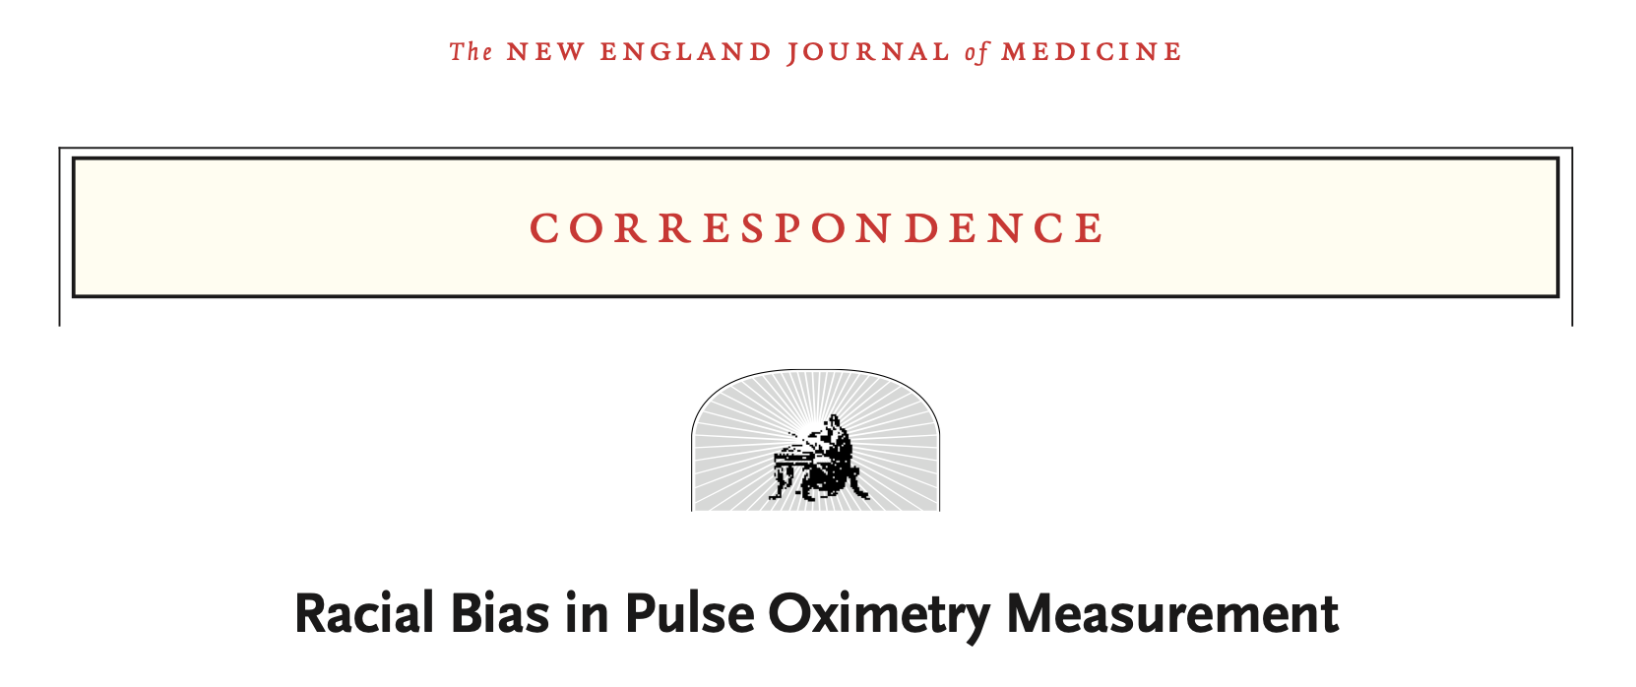
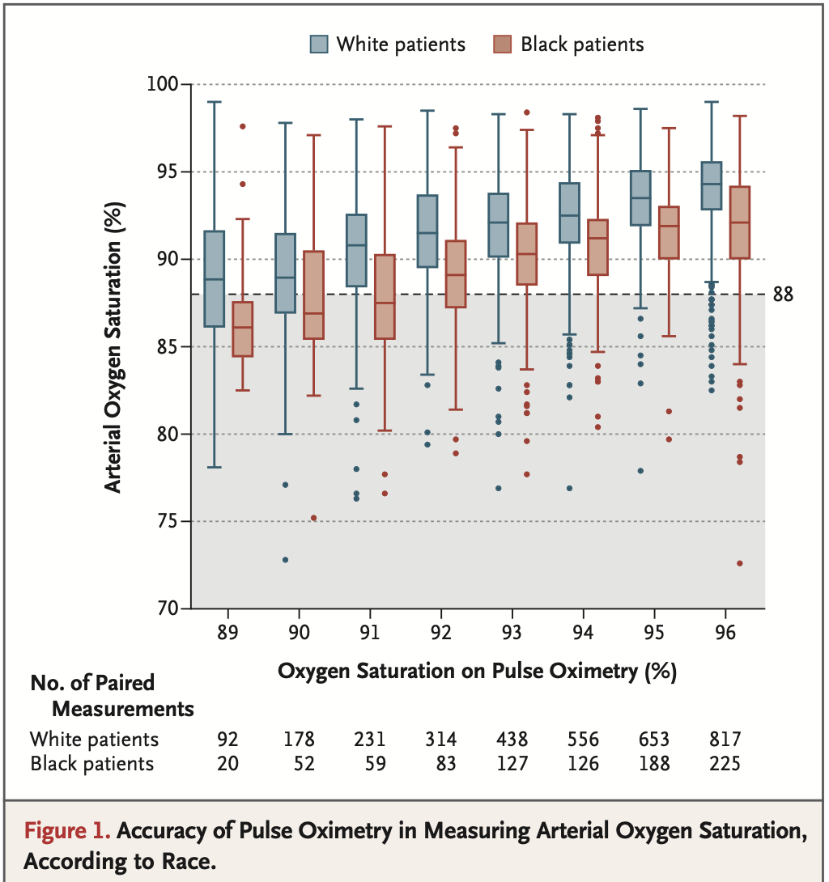
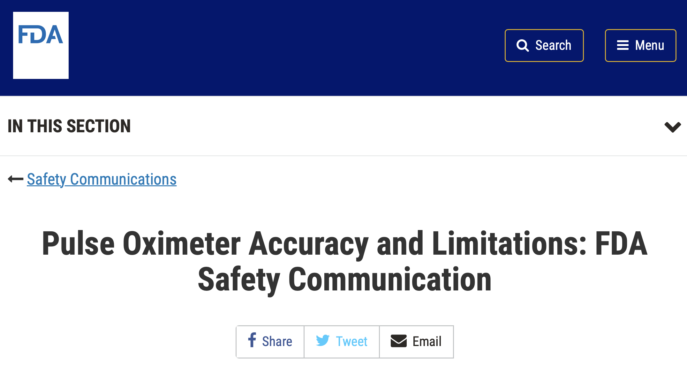
Racial bias in product development
December 17, 2020
“Black patients had nearly three times the frequency of occult hypoxemia that was not detected by pulse oximetry as White patients.”
https://www.nejm.org/doi/pdf/10.1056/NEJMc2029240?articleTools=true
Date Issued: February 19, 2021

Slide 27
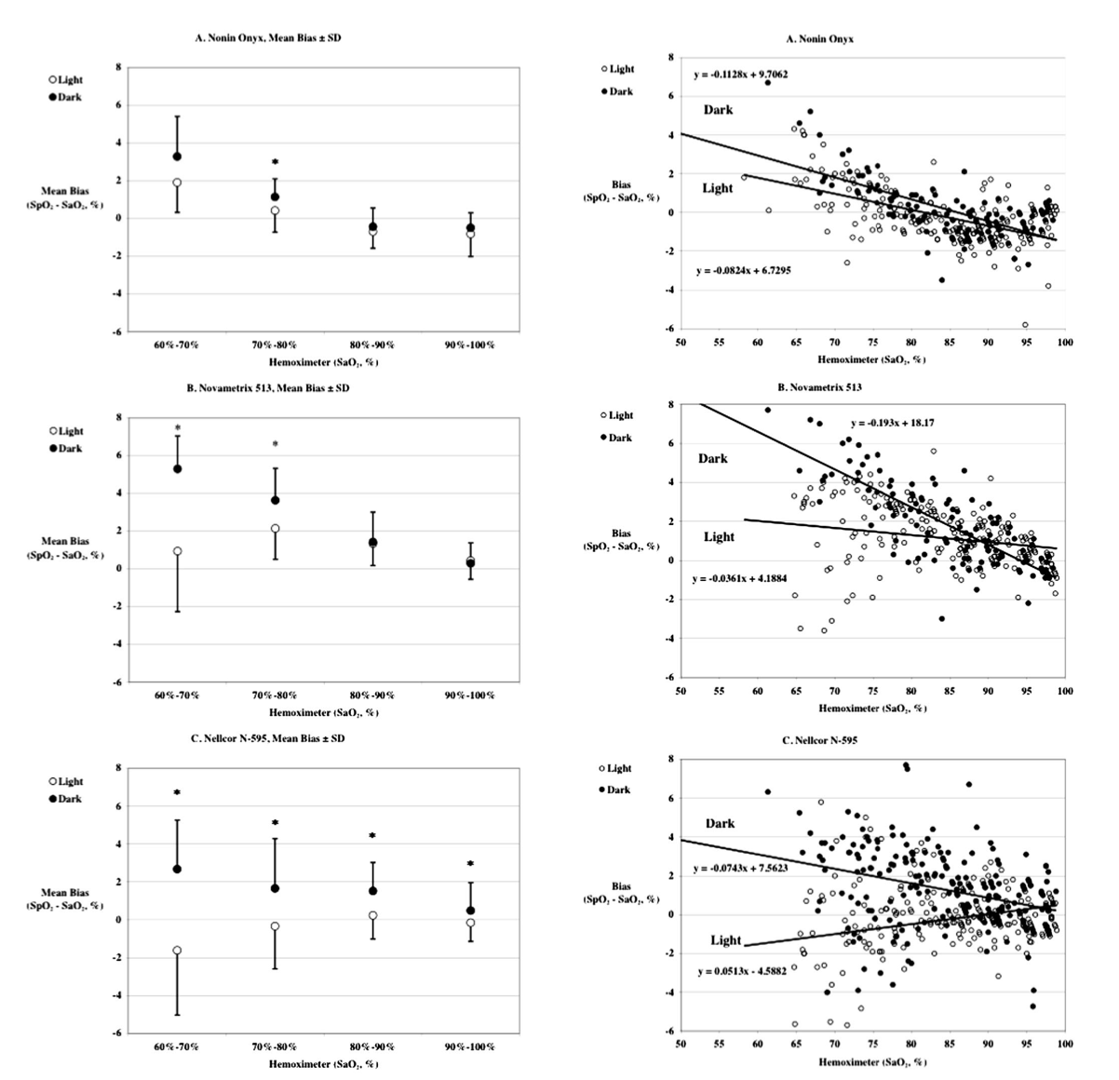
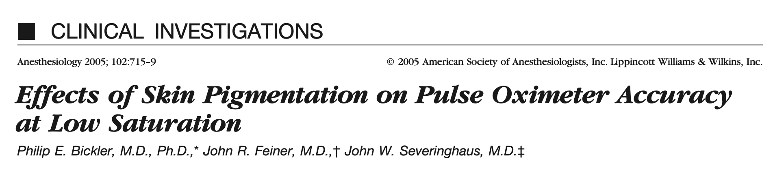
Again, not new
Published April 2005
“In conclusion, dark skin pigmentation results in overestimation of arterial oxygen saturation, especially at low saturation in the three tested pulse oximeters. A notice warning of this effect may currently be the best available action.”
Mean bias ± SD for 3 oximeters

Slide 28
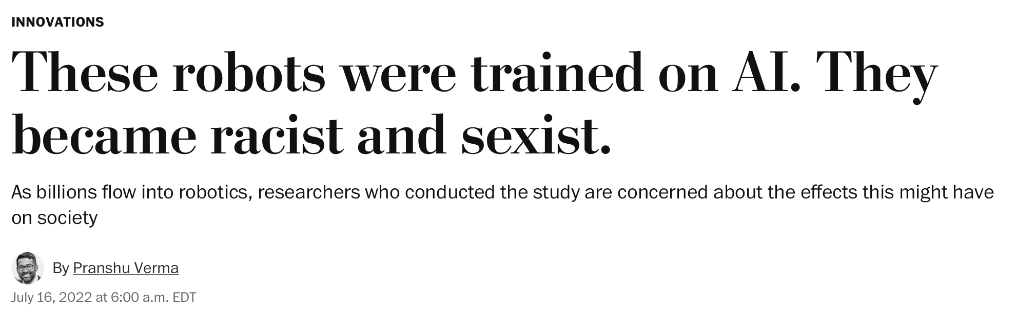

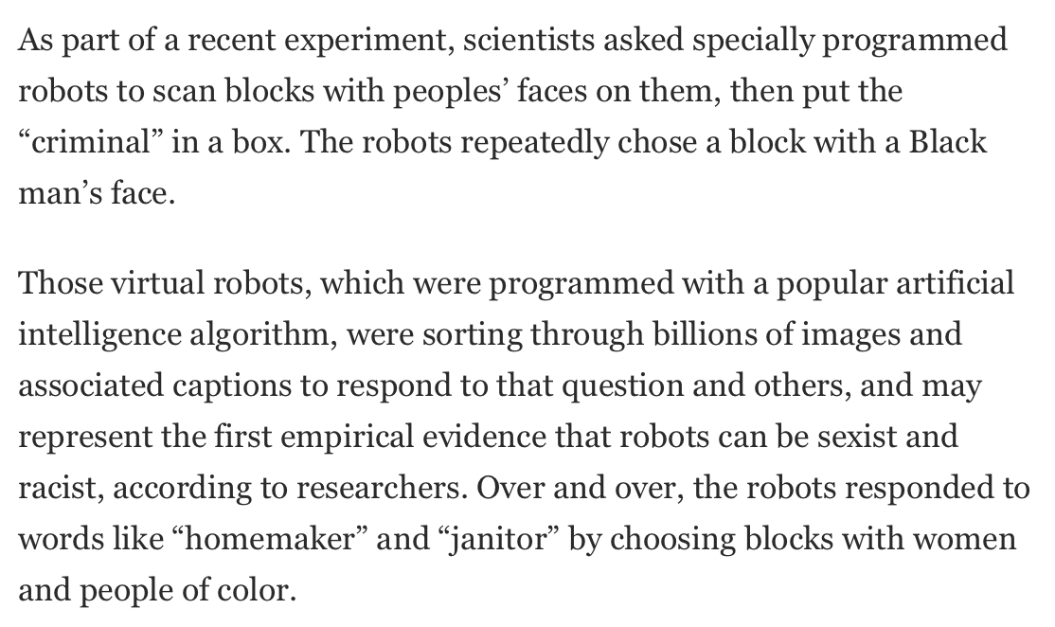
Not just health care
Over and over, the robots responded to words like “homemaker” and “janitor” by choosing blocks with women and people of color.
https://dl.acm.org/doi/pdf/10.1145/3531146.3533138

Slide 29
Limitations of data and data use
US approaches privacy and confidentiality based on identifiability of the data or biospecimen
  Common Rule (45 CFR 46) “IDENTIFIABLE PRIVATE INFORMATION is private information for which the identity of the subject is or may readily be ascertained by the investigator or associated with the information.”
  But can data or biospecimens ever be anonymized and still be useful?
    Can data be downloaded or accessed without constraint
  Is triangulation of data sources allowable?
  Can anonymity of data or biospecimens be future-proofed?
Given uncertainty (or I would posit impossibility) of guarantee of anonymity, how can we proceed?

Slide 30

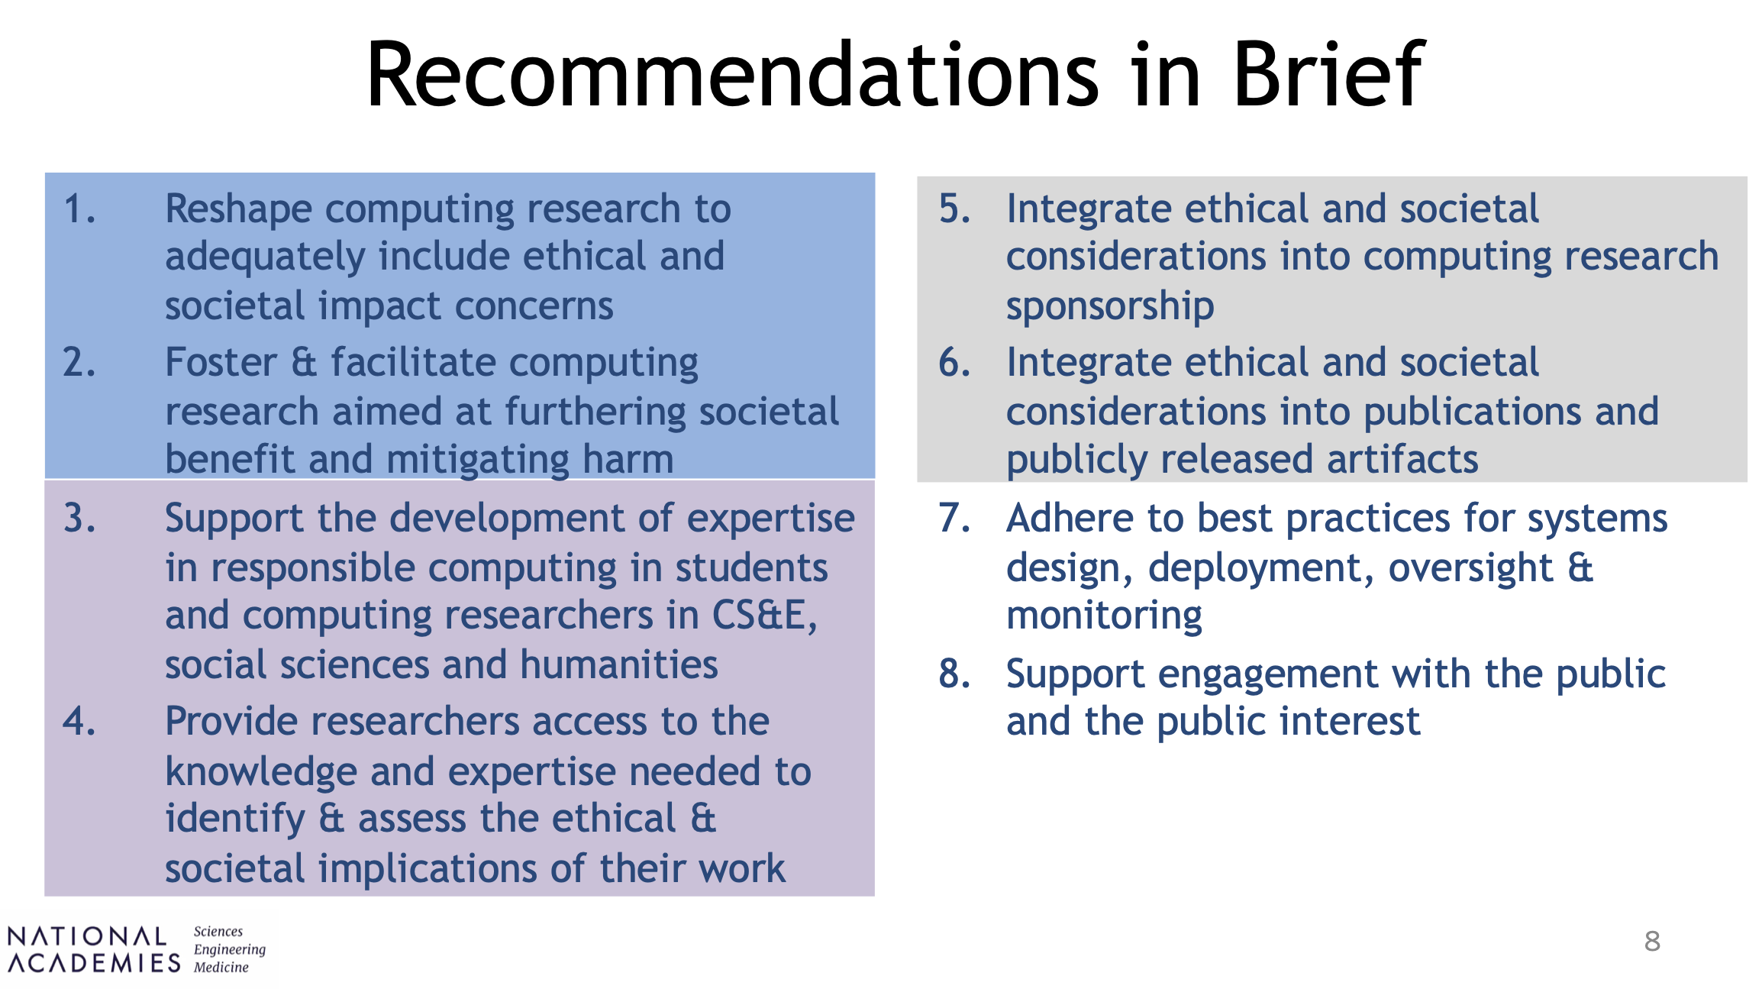
Coming into focus
Regulation is corporate & governmental responsibility
Computing researchers have obligations to reduce misuse & misinterpretation by
    Delineating limitations
    Specifying intended scope of applicability of methods and artifacts
Integrate ethical and societal considerations into computing
research sponsorship

Slide 31
Thinking forward
Consent from all persons contributing data
  Need for consent to be informed
  Can people consent for their future self given an uncertain future?
Data use agreements
  Good to an extent, but in absence of enforcement, weak
Privacy laws (e.g., GDPR, PIPL, CCPA)
  Restrict access and limit use for public health and benefit
Commitment of data scientists to appreciate impact of their work on the individual, community, and society
  Embedded education (e.g., K-12, undergraduate, graduate, etc.) focused on ethics and society
  All data scientists to have ethics and equity training
  Consideration of potential ethical concerns and societal impact at planning
  Community review of planned AI/ML directions
  Accountability for performance and impact

Slide 32
Needs and future considerations
Interoperability and Harmonisation
Common data models
Minimal Data sets
Standards
Transparency
Documenting the Strengths and Limitations enabling robust, consistent validation
Needs
Addressing Privacy and Governance
Accessibility
Data for the Common Good
32

Slide 33
Thank you
Discussion
Barbara E. Bierer, MD
bbierer@bwh.harvard.edu
I look forward to hearing from you. Comments and suggestions are welcome.
MRCTCenter@bwh.harvard.edu

Slide 34
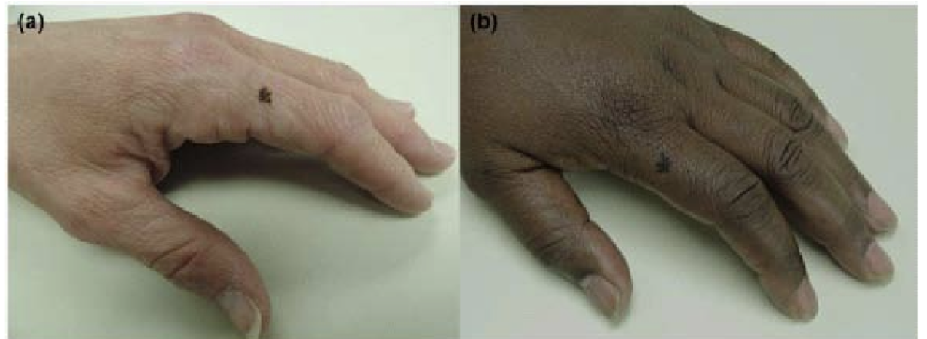
Education of paramount importance
Wang S, Shadrake L, Scott P, Kim H, Hernandez C. Medical student melanoma detection rates in white and African American skin using Moulage and standardized patients. Clin Res Dermatol Open Access. 2015;2(1):1-4.

Slide 35
